Slide 1
US Census Bureau Updates
October 2023
Planning for 2030 – 2030 Census FRN Results
Special Census
Geographic Program Update – Block Counts
Arizona Tribal Nation Engagement
Demographic Survey Updates
Transition to USAJOBS
Tamia Morris, Decennial Specialist
Jim Castagneri, Geographer
Charles Tippeconnic, Tribal Relations Specialist
Denver Regional Office, Denver
U.S. Census Bureau
Notes:
Good morning Allen, thank you for inviting us to the Arizona State Data Center Annual meeting. I am joined by two people that you are probably very familiar with Regional Office Geographer Jim Castagneri, and tribal relations specialist Charles Tippeconic. I’ll give them a chance to introduce themselves to those who are not familiar with them. As you can see from the bullet points, we have a lot discuss today, so I'm going to jump right in.

Slide 2
Planning for 2030:
2030 Census FRN Results
Notes:
First, I’m going to provide some brief highlights from the results of the 2030 FRN then wrapped up in November 2022

Slide 3
Received over 8000 comments
Based on public feedback, the Census Bureau
identified 4 projects for development,
expanded 3 current research projects, and
initiated 2 new research projects for the 2030 Census research program.
2030 Census FRN Results
Notes:
The Census Bureau held a public webinar on October 17, discussing some of the results from the public feedback from the FRN. Over 8000 comments were received from the public providing feedback on new projects and areas that we can expand our research products. More than half contained ideas that are already being worked on as part of 2030 Census research.

Slide 4
2030 FRN - Projects Recommended for Development
Census Questionnaire Assistance (CQA) and Contact Strategies – This project aims to better support respondents when they have questions about filling out their census questionnaire.
Census Barriers, Attitudes, and Motivators Study (CBAMS) – This project will look at expanding research efforts of CBAMS in Puerto Rico when possible and investigating methodological options to add Island Areas to the study.
Easing Access to Census Information – This project will focus on making it easier for people to get information about the census via QR codes and other methods.
Administrative Data Sources – This project will look at accessing data from additional sources, such as data from the Federal Student Aid program and the National School Lunch Program.
Notes:
The Census Bureau identified 4 projects for development – CQA, CBAMS, Access to Information and Admin Data Sources
CQA - Live webchat functionality and a chatbot component are being considered as possible options to improve access and customer support.
CBAMS – Read slide
Access – Read Slide
Admin Data – Read Slide

Slide 5
2030 FRN - Expansion of Research Projects Underway
Tailored Contact Strategies – The current objective of this project is to examine the use of tailored contact strategies that incorporate in-office enumeration methods and estimated response propensities.
Research to Improve Communications, Messaging, and Advertising Effort – The current objective of this project is to conduct research that will inform a data-driven communications and advertising campaign to increase self-response and improve data quality.
Enhance External Engagement – The current objective of this project is to explore ways the Census Bureau might be able to equip partners and stakeholders to increase their capacity to support the census, identify gaps, and leverage networks to further activate resources, such as local trusted voices, and improve response.
Notes:
The Census Bureau identified 3 research projects that should be expanded – Contact Strategies, Improving Messaging and Communication, and Enhancing External Engagement
Tailored Contact Strategies - We intend to expand this scope by researching the possibility of using a mass texting campaign to announce the Census Day, and to encourage response.
Research to Improve Communications, Messaging, and Advertising Effort - We intend to expand this scope by researching the messaging around the fact that the National Archives and Records Administration (NARA) does not release census results for 72 years, in order to build additional trust in the confidentiality of response data.
Enhance External Engagement - We intend to expand this scope to include research of a partnership system that will allow requests for specific materials and information. In addition, we will engage with disability advocacy organizations and communities to improve future Census Bureau engagements.

Slide 6
2030 FRN - New Research Projects
Message for Future Generations – This project will consider the feasibility of adding an option to the 2030 Census questionnaire to capture a “time capsule” message, hopefully to help increase self-response and participation in the 2030 Census.
Cultural Competency Training – This project will research options and feasibility of cultural competency training for Census Questionnaire Assistance (CQA) and field staff.
Notes:
The Census Bureau identified 2 new projects that should be added to the 2030 Census research program.
Message for Future Generations - Based on Federal Register Notice (FRN) feedback, this “time capsule” message would allow the public the ability to leave a personalized note to engage with future generations. If feasible, the public could access these notes 72 years after Census Day when released by NARA.
Cultural Competency Training - This project will help define the training content, the number of training modules, who would take training, and possible cost to develop modules.

Slide 7
Want More Info on the 2030 Census?
Check out the 2030 Census Research Project Explorer
Visit census.gov and search for 2030 Census

Slide 8
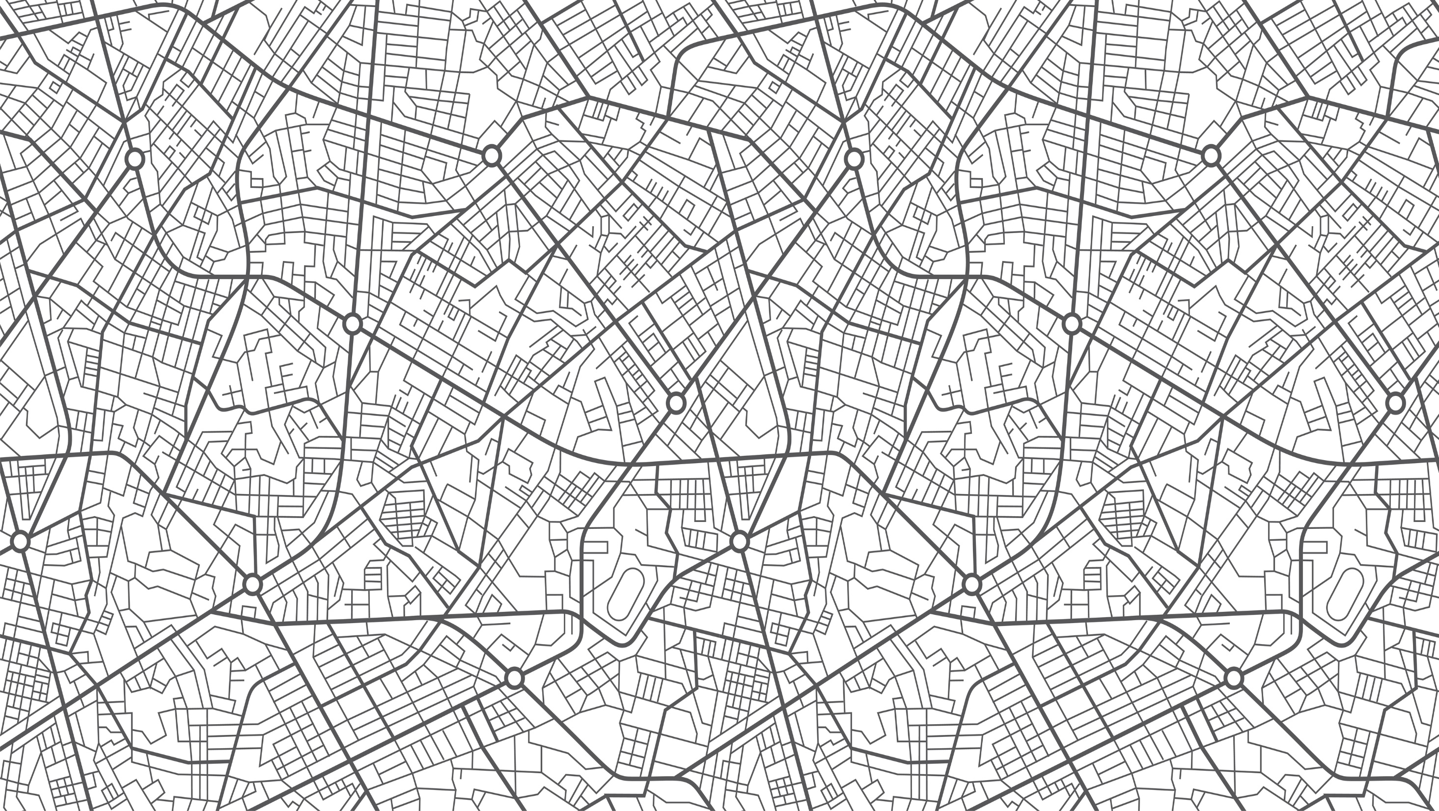
2020 Special Census Program
Notes:
Next we'll discuss the 2020 Special Census Program.

Slide 9
2020 Special Census Program
A Special Census (SC) is a basic enumeration of population, Housing Units (HU), Group Quarters (GQ) and Transitory Locations (TL) conducted by the U.S. Census Bureau at the request of the Governmental Unit (GU).
A special census is conducted between decennial censuses.
Governmental units include state, county, city, or other political subdivisions within a state. It also applies to American Indian reservations, the Island Areas, Puerto Rico, and the District of Columbia.
It is conducted at the request of a Governmental Unit on a cost reimbursable basis.
9
Notes:
On March 30, 2023 the Census Bureau began accepting requests for special census cost estimates. The Special Census Program is offered each decade to provide local jurisdictions with an enumeration of their population, housing units, group quarters and transitory locations between decennial censuses.

Slide 10
Why Request a Special Census?
Special censuses may be requested when:
Governmental units experience large population growth. Either normal population growth or specific population growth related to group quarters or transitory locations.
There has been a significant change in a community due to annexation, boundary change, or municipal incorporation.
A common benefit to local jurisdictions is the potential increase in state revenue sharing.
Contact the state data center for more information about your governmental unit.
10
Notes:
Local officials may be interested in requesting a special census if they believe their community’s population size or demographic composition changed considerably after the 2020 Census, for example, because of annexation or new construction. A special census cannot review or recount 2020 Census results but may be used to update the Census Bureau’s population estimates.

Slide 11
How is the Special Census Conducted?
Internet Self-Response (New for 2020 SC Program)
At the start of the Special Census, the Census Bureau will send a letter to housing units, inviting them to respond online
Field Enumeration
Field representative will follow up after the end of the self-response period. This includes:
Listing to add, delete or update HU addresses observed on the ground
Interviewing respondents who did not self respond
Quality Assurance (Reinterview)
11
Notes:
New for the this iteration of the Special Census is Internet Self Response. The field staff will followup with non-responding households after ISR ends and the QA portion of the operation will begin shortly after the start of field followup.

Slide 12
Full and Partial Special Censuses
A full special census is a basic enumeration of population, Housing Unit- HUs, Group Quarters GQs, and at Transitory Locations TLs for an area entirely within the jurisdiction of the governmental unit requesting the special census.
A partial special census is conducted using the same methodologies and procedures as a full special census, but it is for a subset of areas within the jurisdiction of the governmental unit.
For a partial special census to take place, it must contain at least one full Census tract that is completely within the jurisdiction of the governmental unit.
NOTE: The minimum statistical area for which any partial special census can be conducted is a 2020 Census tract. This is different from the 2010 Special Census Program where partial special censuses were delineated at the block level.
12
Notes:
Local officials can request a full or partial special census. Both types are conducted the same way, but a partial special census typically covers a much smaller area than a full special census. For example, governmental units may choose to conduct a partial special census of only selected areas within their jurisdictions — covering at least one full 2020 Census tabulation tract — that might have experienced large population growth or a boundary change.

Slide 13
2020 Special Census Program through the Decade
Spring 2O23
Cost estimate request opens
January 2024
June 2027
Internet Self-Response (ISR) begins
Cost estimate request ends
September 2028
Special Census program ends
February/March 2024
First production field work begins
Special Census Production
Notes:
Here is the timeline for the Special Census program. January 2024 is the earliest a Special Census can begin. June 2027 is the latest a request for cost estimate can be submitted. The program previously closed on Sept. 30, 2018, to accommodate the taking of the 2020 Census. Similarly, the program will conclude by Sept. 30, 2028, ahead of the 2030 Census.

Slide 14
Additional Resources
Special Census Website:
https://www.census.gov/programs-surveys/specialcensus.html
Results of past SCs:
https://www.census.gov/programs-surveys/specialcensus/data_products/official_counts.html
For general questions, please email dcmd.special.census@census.gov
For geography-related questions or inquiries, contact Jim Castagneri by email james.d.castagneri@census.gov or call (720) 962-3880.
14

Slide 15
Questions?
15

Slide 16
Geographic Program Updates

Slide 17
Geographic Program Update Current Address Count Listing Files
In addition to local and regional efforts to track and record housing and population change using GIS, the Census Bureau now has a new dataset to assist in this effort.
Called the Address Count Listing Files, these data represent the latest tabulation available of residential housing units by census block and are updated bi-annually.
More information on these files and how to download them can be found here:
https://www.census.gov/geographies/reference-files/2023/geo/addcountlisting.html

Slide 18
Geographic Program Update
Current Address Count Listing Files
The files are updated biannually and include total housing units (including transitory locations) and total group quarters counts as of July 2023, by current tabulation block.
These files are created for all 50 States, Washington, DC, Puerto Rico, and Island Areas
The files are pipe-delimited and are named using the following convention: <stcode>_<name>_AddressBlockCountList_<mm><yyyy>.txt

Slide 19
TIGER/Line Partnership shapefiles are issued every year for our Boundary and Annexation Survey (BAS) and other partnership efforts. They reflect the block splits necessary to join the revised block counts to a geography.
https://www.census.gov/geographies/mapping-files/time-series/geo/partnership.html
Address Counts can be viewed here:
https://mtgis-portal.geo.census.gov/arcgis/apps/webappviewer/index.html?id=c754be823d6342949a4c50e519eb87be
Geographic Program Update
Current Address Count Listing Files

Slide 20
Arizona Tribal Nation Engagement

Slide 21
Tribal Relations Specialist Program Charles Tippeconnic, Tribal Relations Specialist Denver Regional Office charles.tippeconnic@census.gov

Slide 22
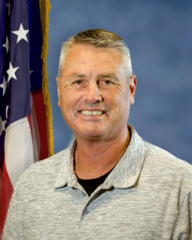
Tribal Relations Specialist Team
Shadana Sultan
Oglala Lakota Nation (SD)
Lives in Denver, CO. Corp & Org Communication & Marketing Western KY Univ, Certificate of Leadership HarvardX. Lakota, Spanish, Arabic, and French. Broadcast Media, online, and event marketing experience with ABC, NBC, & Telemundo. Former Executive Director of AIAN nonprofit.
Charles Tippeconnic
Comanche Nation (OK)
Lives in Elgin, OK. BS in Petroleum Engineering from the Univ of Oklahoma. Secondary Education program from Univ of Central OK. Mathematics Teaching license. Lifetime of service & professional career in the public sector focused on service to Native Americans by working directly for Tribal Governments or with Federal Agencies that serve Tribal Communities
Alaina Capoeman-Davis
Quinalt Nation (WA)
Lives in Suquamish, WA. BA from The Evergreen State College and upcoming MBA from Gonzaga University. She has served two Decennial Census tours with the Tribal Partnership program. She is active in her canoe family and as a jingle dress dancer.
Bernadece Boda
Odawa Nation (MI)
Lives in Laguna Alanson, MI. Management, Criminal Justice, and Social. She has worked within Indian Country for nearly 20 years. She has served as Chairperson for her Tribe's Gaming Authority. She has experience at varying levels of government, including City, State, Tribal and Federal positions.
Notes:
These are the Tribal Relations Specialists and their bios. (read bios if necessary)

Slide 23
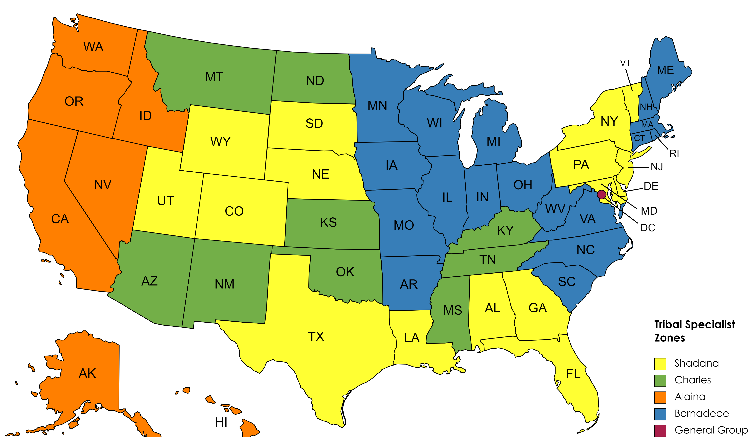
Tribal Relations Overview
Tribal Data Tabulation
Engage Partners
Updates and resources for ongoing surveys
Surveys & Upcoming 2030 Census
Geographic Programs
Cultural Awareness and Engagement
Field and other Directorates
Notes:
The Tribal Relations Program is a new Census Program that provides ongoing support to Tribal Nations and Urban Indian Partners.
The program brought on the first Specialist in Nov 2021, Shadana Sultan of the Oglala Lakota Nation. She's based in Denver and covers the yellow areas on the map. In March 2022, Charles Tippeconnic of the Comanche Nation joined the program. He's based in Elgin, OK and covers the green areas on the map. In July 2022, Bernadece Boda of the Little Traverse Band of Odawa joined the program. She is based in Alanson Michigan and covers the blue areas on the map. In July of 2023, Alaina Capoeman-Davis of the Quinalt Tribal Nation joined the program. She is based in Suquamish WA and covers the orange areas on the map.
The objectives of the program are:
To assist with Tribal Data Tabulation. The Specialist work with Tribal Nations to secure access permissions for Field Staff to collect data.
Engage Partners throughout the non-Decennial years to increase Tribal engagement & participation in surveys & 2030 Census
Provide Updates and resources related to ongoing surveys by engaging & educating our Tribal Partners
Provide support for ongoing Surveys & planning for Upcoming 2030 Census. An example of that might be to increase AIAN staff within Field Division
Support with Geographic Programs by increasing participation in Geo programs like BAS annually.
Conduct Cultural Awareness and Engagement training sessions for Census Staff that work in and around Indian Country. Specialists are gathering input and feedback from partners regarding what they want visitors to their communities to know before entering, so we may be respectful in that process.
Support Field and other Census Directorates. An example of this might be generating interest and/or referrals for Data workshops.
This program provides an opportunity for Census to have a two way conversation of how Census can support and better inform Indian Country.

Slide 24
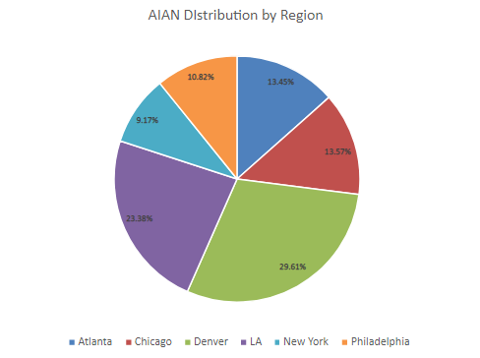
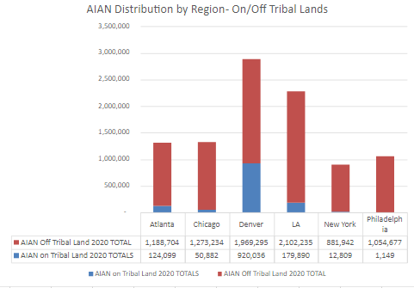
Regional Tribal Numbers
Notes:
The first chart shows total counts of AIAN alone or in combination with other races, by Region. It also reflects how many of those are on Tribal Lands (blue) and those living off Tribal Lands (red), according to the 2020 Decennial Census.
One interesting observation – in 2017, Census did an AIAN profile for American Indian Heritage Month https://www.census.gov/newsroom/facts-for-features/2017/aian-month.html projecting the AIAN alone or in combo population to be 10.2 mil in July 2060. According to 2020 Decennial, that population already reached 9.7 mil. The majority of that growth was off Tribal Lands.
The pie chart to the right shows the percentage distribution of AIAN by region, according to the 2020 Decennial

Slide 25
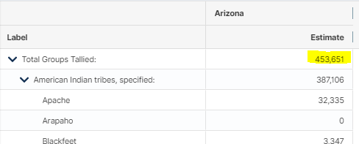
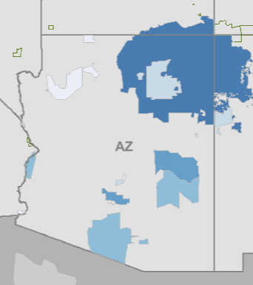
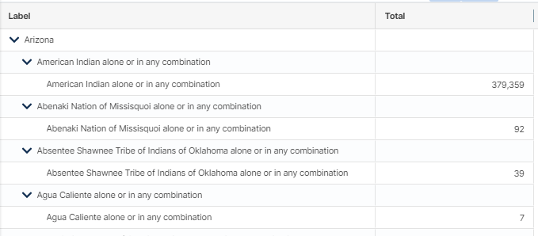
Arizona Tribal Numbers/Links to Data
*click graphics to route to links
Notes:
**All graphics are hyperlinked to the data.census.gov resource that is interactive. You can zoom in maps and click on items in the maps for more info.
There are Twenty-Two (22) Federally Recognized Tribal Nations in Arizona including the Navajo Nation which is the largest Tribal Nation by population and by land area. The Navajo Nation also extends into the States of Utah and New Mexico.
This map on the left reflects the AIAN Alone or in Combination with other Races numbers on Tribal Areas within Arizona according to the 2021 5yr ACS release. These numbers are for all AIAN that live in these areas, not just those enrolled in these specific Tribal Nations.
These are the AIAN Tribal Groupings for the State of Arizona. According to the 2021 5yr ACS Release, there are 453,651 AIAN alone or in combination with other races in Arizona. This is a breakdown of Tribal Groupings represented.
This map on the right reflects the AIAN alone or in combination with other races in Metro Statistical areas of Arizona, according to the 2021 5yr ACS Release. *click on any of the areas to show the numbers

Slide 26
Demographic Survey Updates

Slide 27
National Teacher and Principal Survey (NTPS)
The U.S. Census Bureau is conducting the National Teacher and Principal Survey (NTPS) on behalf of the National Center for Education Statistics (NCES). The NTPS is a nationwide sample survey of elementary and secondary schools and the principals and teachers who staff them. The purpose of the NTPS is to provide policy makers and researchers with relevant and timely data on the characteristics and conditions of America's public schools and professionals who work in them. The data are used to analyze the characteristics of schools, principals, teachers, and students.
The survey has 4 phases, from October 2023 to May 2024:
Field NRFU Phase I: FRs will make personal visits to sampled schools to verify Teacher Listing Forms and distribute Principal and School Questionnaires and provide on-line login information.
Field NRFU Phase 2: FRs will conduct a telephone operation, calling schools to remind them to do the questionnaires.
Field NRFU Phase 3: FRs will make personal visits to sampled schools to collect outstanding NTPS questionnaires.
Field NRFU Phase 4: Collect the send in remaining questionnaires.
Notes:
The National Teacher and Principal Survey (NTPS) is a system of related questionnaires that collect data on the elementary and secondary education in the United States, including teaching and working conditions in our schools, as well as characteristics of the teachers and principals who staff them. The survey is a primary source of information about what is happening in K–12 schools across the United States.
The survey began this month and will closeout in May 2024. There are 4 phases to the survey:
Phase 1 – FRs will make personal visits to the school to drop off the forms and provide login information to the staff.
Phase 2 – The FRs will call the schools to remind them to complete the questionnaires
Phase 3 – The FRs will pick up the completed questionnaires
Pase 4 – Is the final pickup and closeout of the survey

Slide 28
Ongoing Current Surveys in Arizona
American Community Survey (ACS)
Consumer Expenditure Survey (CE)
Current Population Survey (CPS)
National Health Interview Survey (NHIS)
National Crime Victimization Survey (NCVS)
Survey Of Construction (SOC)
Survey of Income and Program Participation (SIPP)
6 Field Supervisors
113 Field Representatives
Notes:
This is just a reminder that we have 6 Field Supervisors and 113 Field Representatives working throughout Arizona supporting data collection for our ongoing demographic surveys. This list is not all-inclusive, but these are the main ongoing surveys that are in the field every month.

Slide 29
Transition to USAJOBS

Slide 30
The US Census Bureau has finally transitioned to USA JOBS for local field positions. You can now apply for Field Supervisor and Field Representative positions ONLINE!
Links to Current Job Openings:
USAJOBS - Job Announcement - Field Representative
USAJOBS - Job Announcement - Field Representative (Bilingual)

Slide 31
THANK YOU!

