Slide 1
Updates to data.census.gov and Using the Microdata Access Tool
Arizona State Data Users Meeting
October 25, 2023
Kanin Reese
Center for Enterprise Dissemination (CED)
U.S. Census Bureau

Slide 2
data.census.gov and the Microdata Access Tool
  Latest Updates to data.census.gov
  Future Updates to data.census.gov
  Finding Detailed DHC-A Data in data.census.gov
    Getting Started: Detailed DHC-A Default Tables
    Selecting Multiple Geographies: Navajo Nation alone or in any combination population for all census tracts in Apache County, AZ
    Selecting Multiple Population Groups: All available Hispanic origin groups in Maricopa County, AZ
  Finding Data in the Microdata Access Tool
    Place of birth by single year of age in Arizona
  Resources

Slide 3
data.census.gov and the Microdata Access Tool
  Latest Updates to data.census.gov
  Future Updates to data.census.gov
  Finding Detailed DHC-A Data in data.census.gov
    Getting Started: Detailed DHC-A Default Tables
    Selecting Multiple Geographies: Navajo Nation alone or in any combination population for all census tracts in Apache County, AZ
    Selecting Multiple Population Groups: All available Hispanic origin groups in Maricopa County, AZ
  Finding Data in the Microdata Access Tool
    Place of birth by single year of age in Arizona
  Resources

Slide 4
Redesign of Table Header

Slide 5
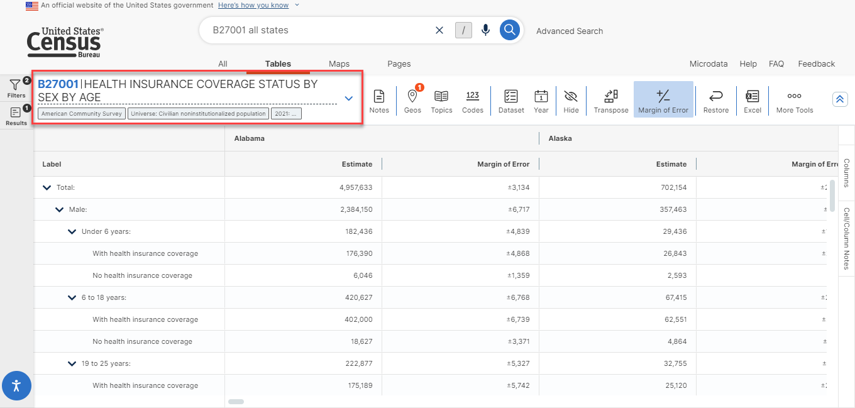
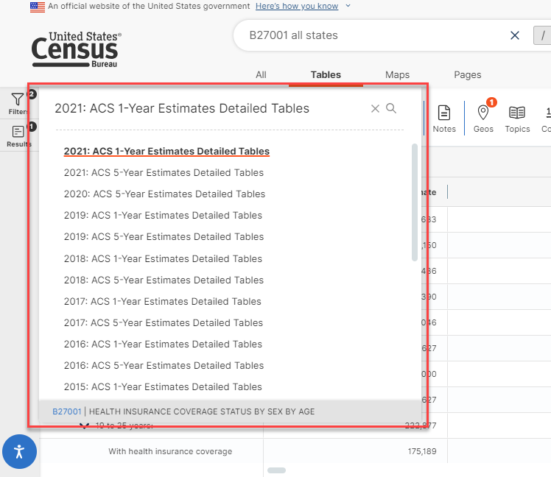
Redesign of Table Header

Slide 6
Redesign of Variable Section (Mapping)

Slide 7
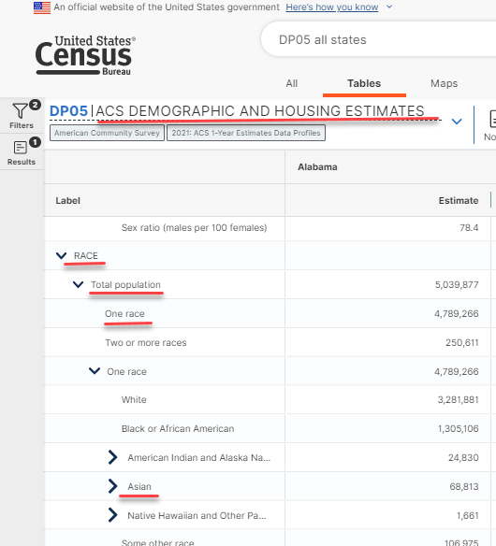
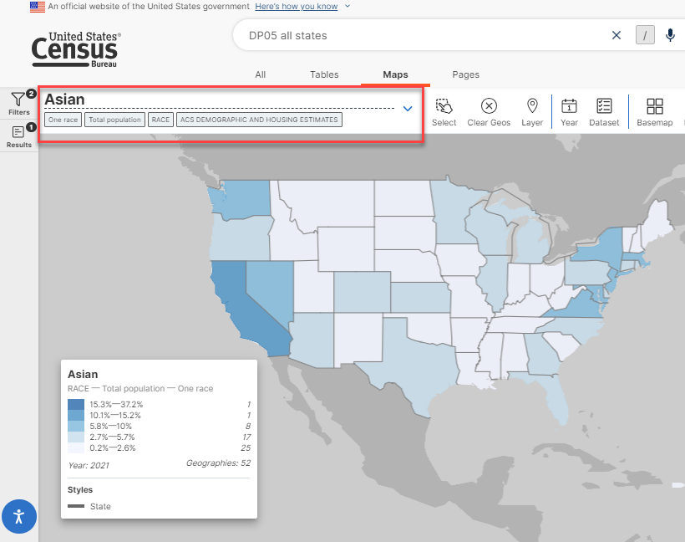
Redesign of Variable Section (Mapping)
Name of table now appears in the heading, along with labels relevant to the variable shown in the map

Slide 8
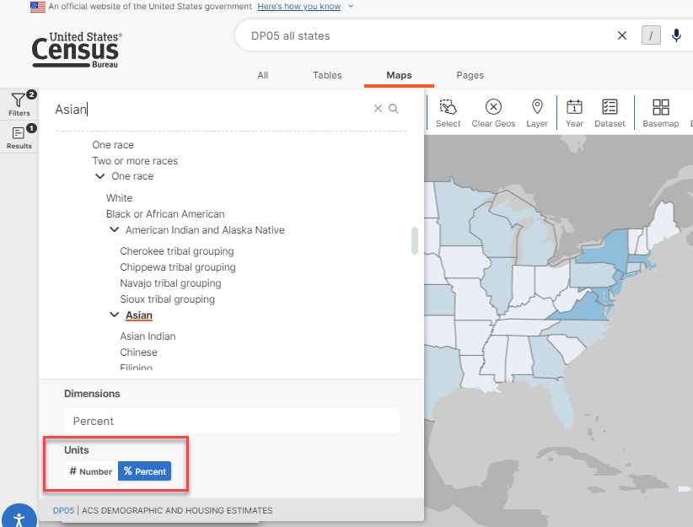
Redesign of Variable Section (Mapping)
Instead of scrolling through a long list, you can quickly switch between Number and Percent estimates

Slide 9
Geographic and Industry Profiles

Slide 10
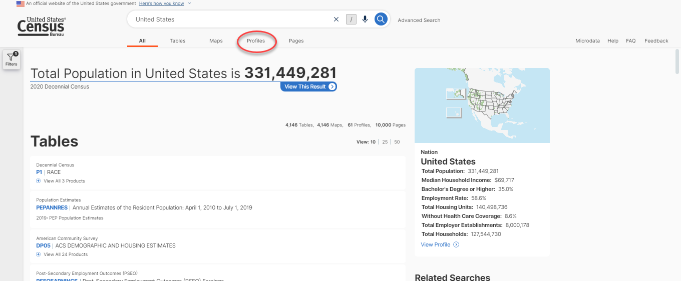
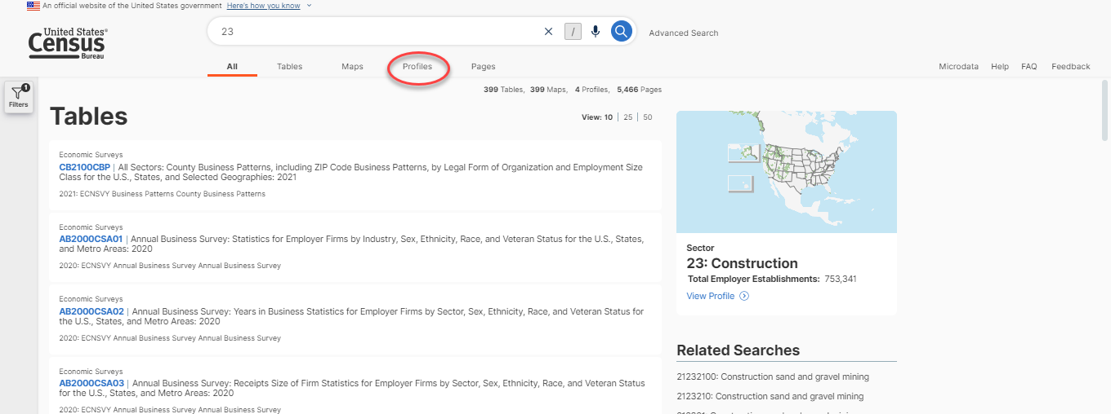
Geographic and Industry Profiles Tab
Click on the Profiles tab to visit geographic or industry profiles related to your search

Slide 11
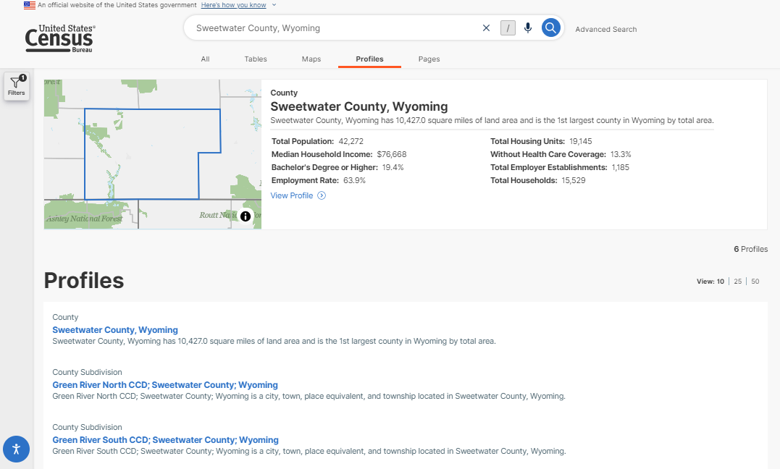
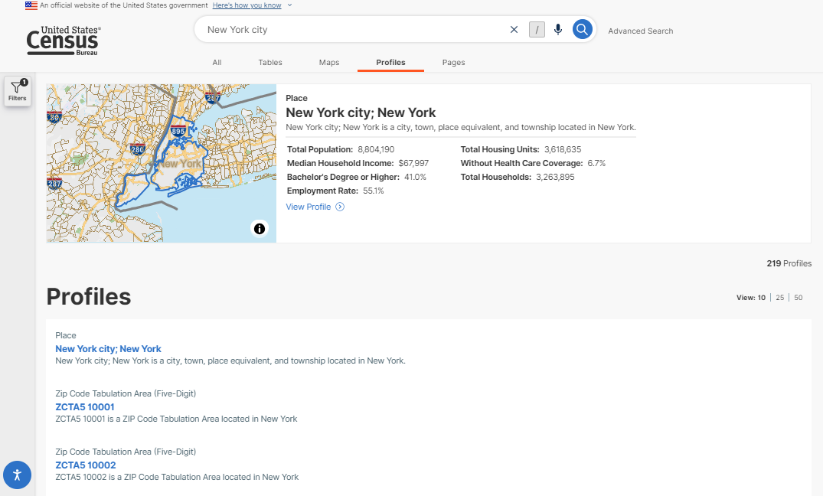
Geographic Profiles Tab
View geographic profiles related to your search
Can also view profiles for related geographies

Slide 12
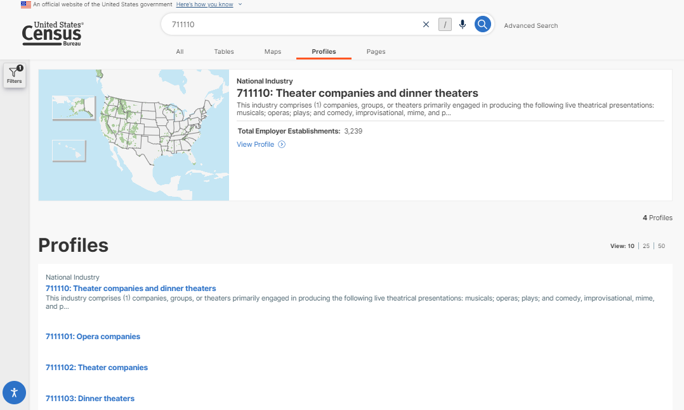
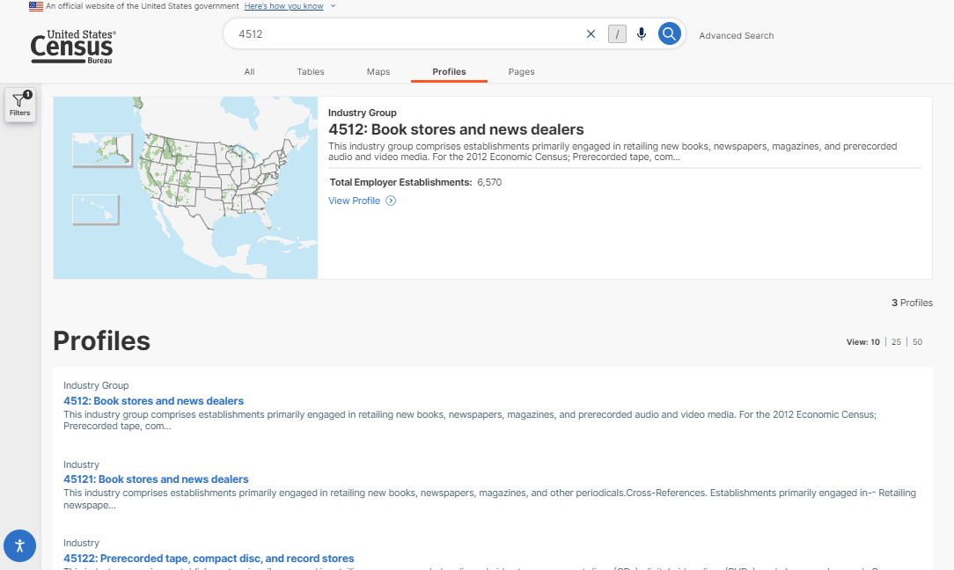
Industry Profiles Tab
View industry profiles related to your search
Can also view profiles for related industries

Slide 13
Exposure of Filters

Slide 14
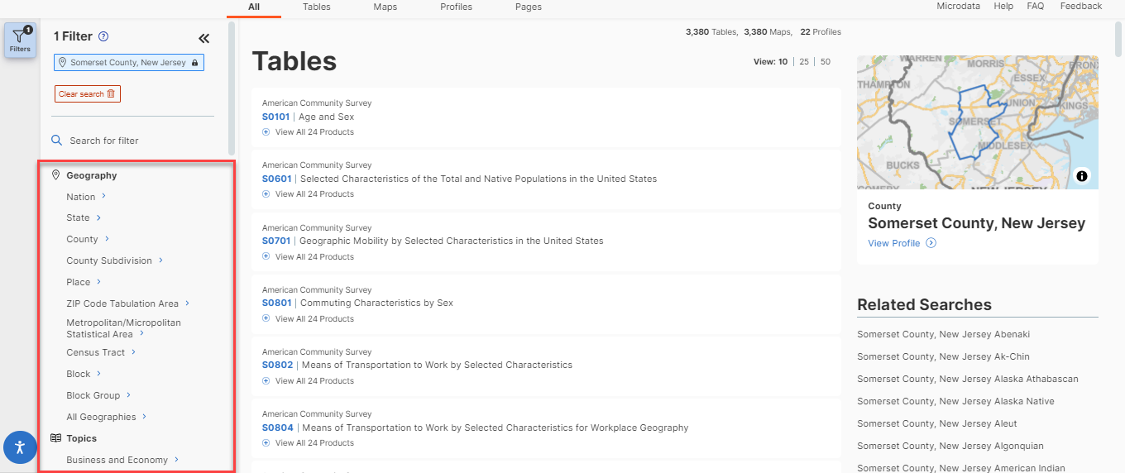
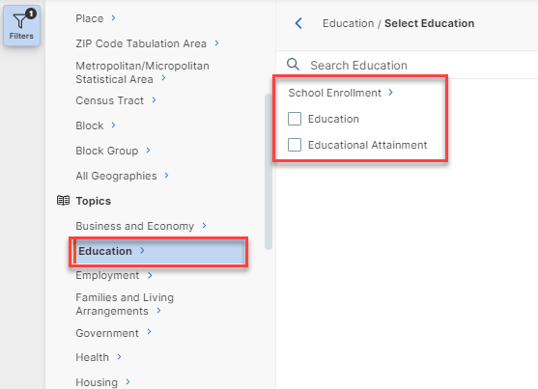
Exposure of Filters
Filters appear on left-hand navigation, rather than solely in the middle filter panel

Slide 15
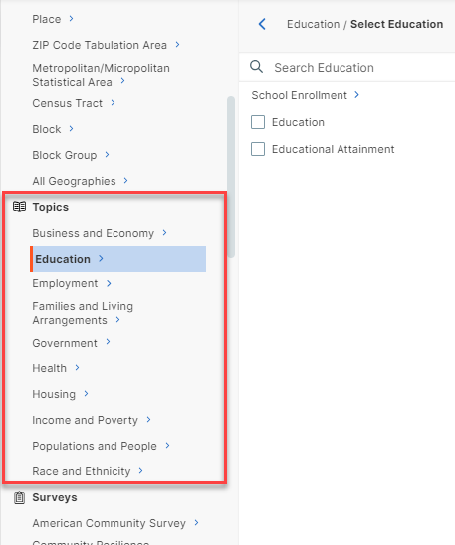
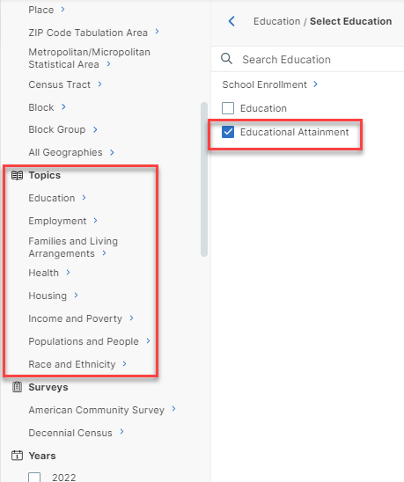
Exposure of Filters
When a selection is made, the list on the left updates according to filters that are compatible with the selection
E.g., when ‘Educational Attainment’ is selected, the Business and Economy filter is removed, as there are no tables that look at educational attainment and business and economy

Slide 16
Citations

Slide 17
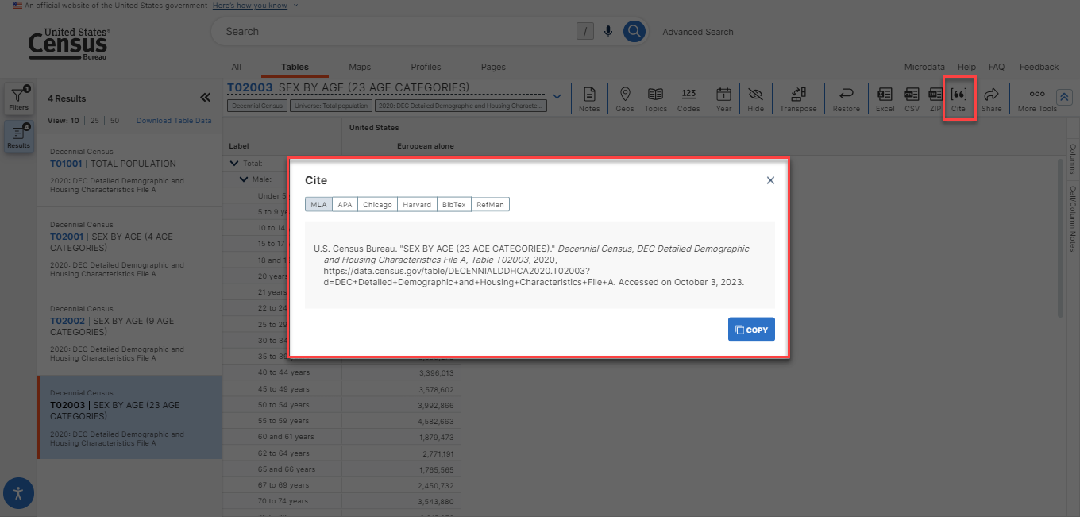
Citations

Slide 18
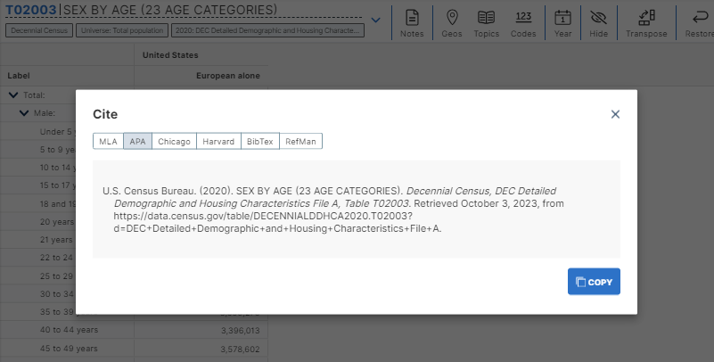
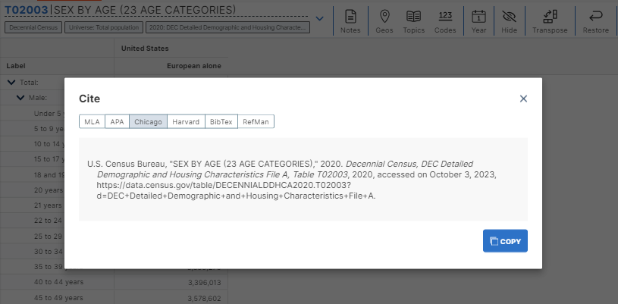
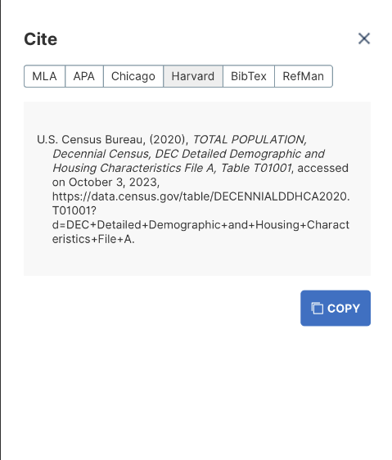
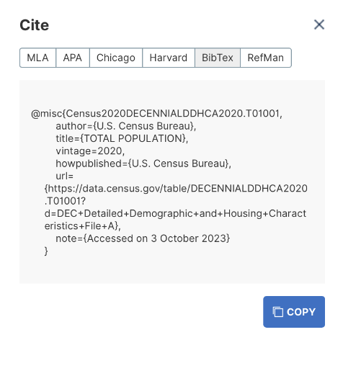
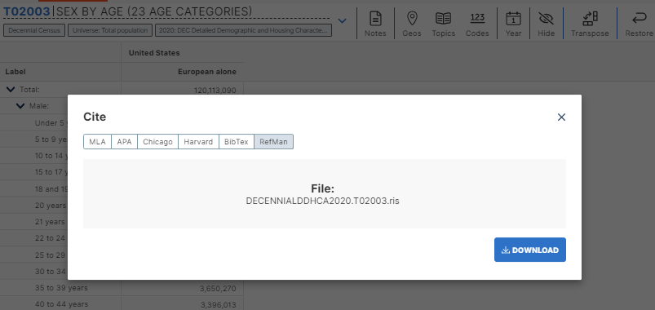
Citations

Slide 19
Pop Stories

Slide 20

Pop Stories

Slide 21
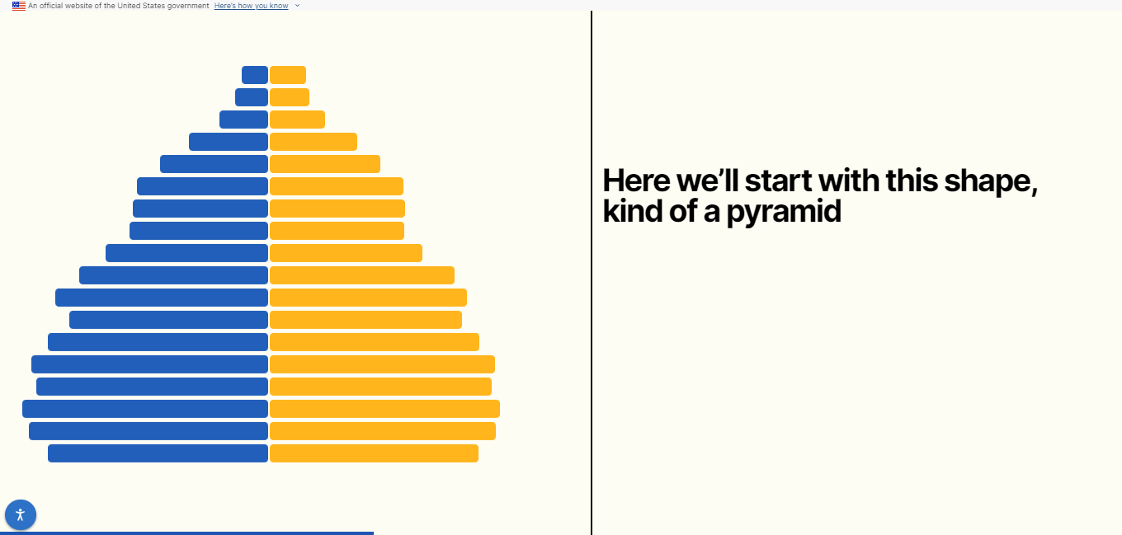
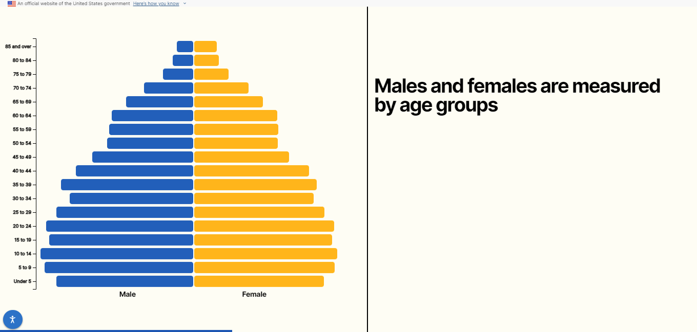
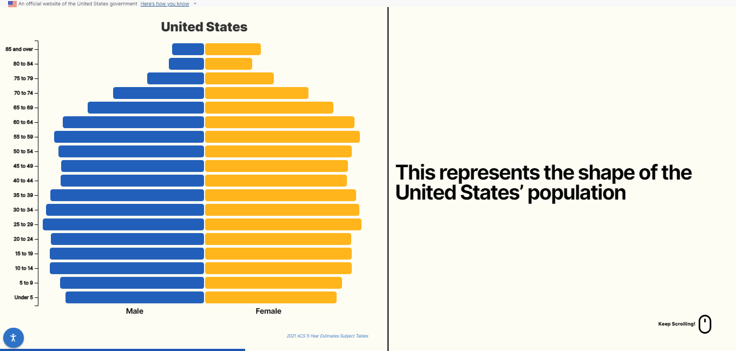
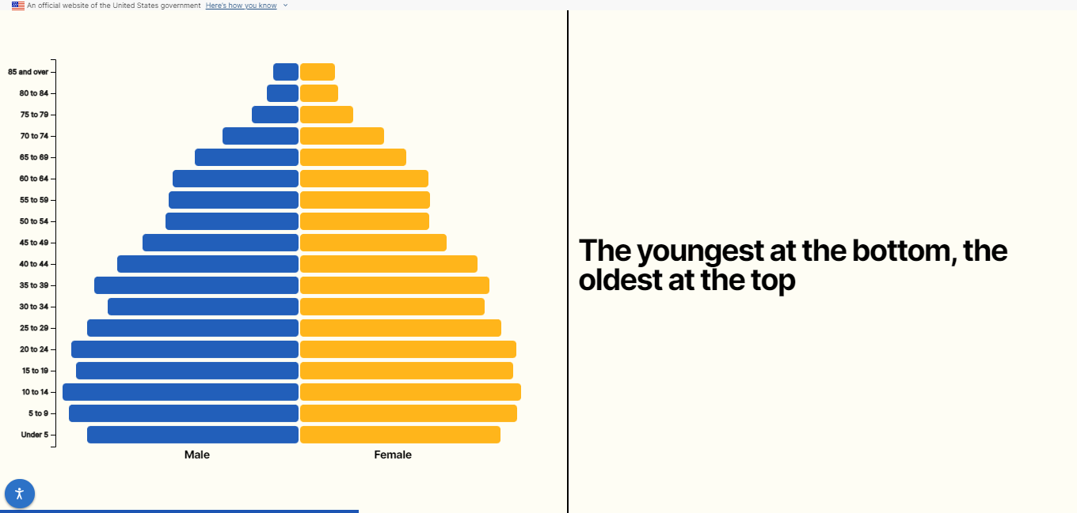
Pop Stories Overview
Overview of pop story is given by describing how population pyramids look, as well as how they can be interpreted

Slide 22
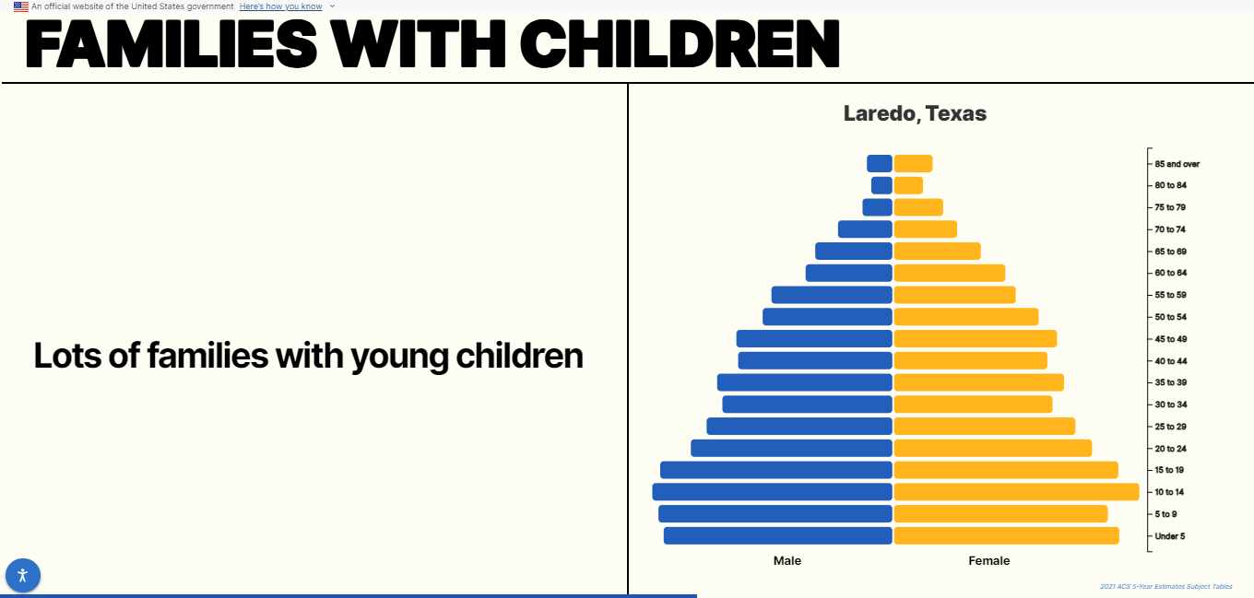
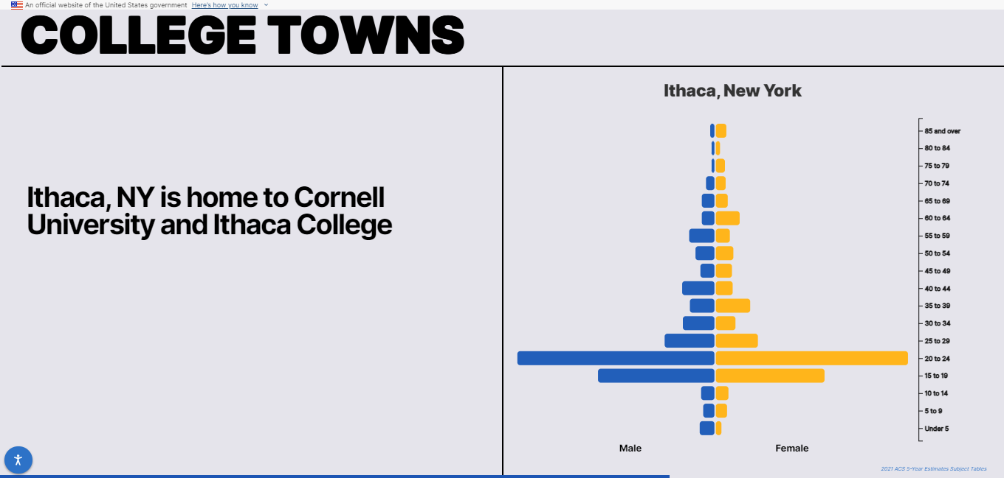
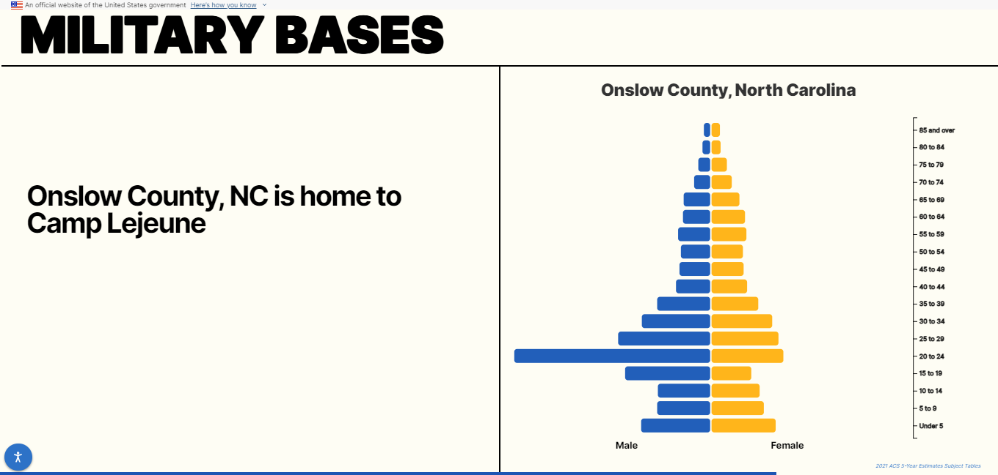
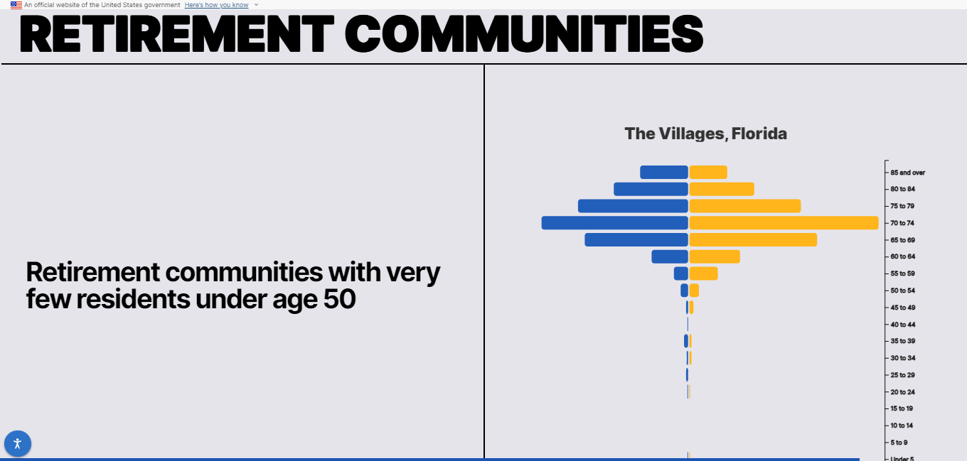
Pop Stories Overview
Explanation continues by looking at communities that are good representations of different populations, such as the college-age group and people living in retirement communities

Slide 23
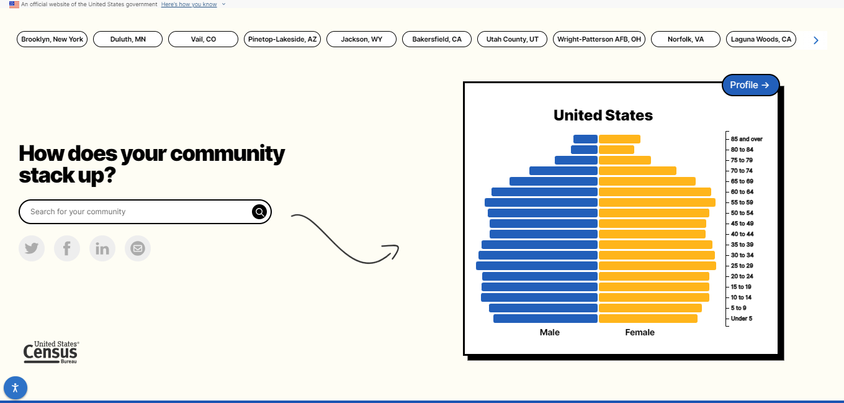
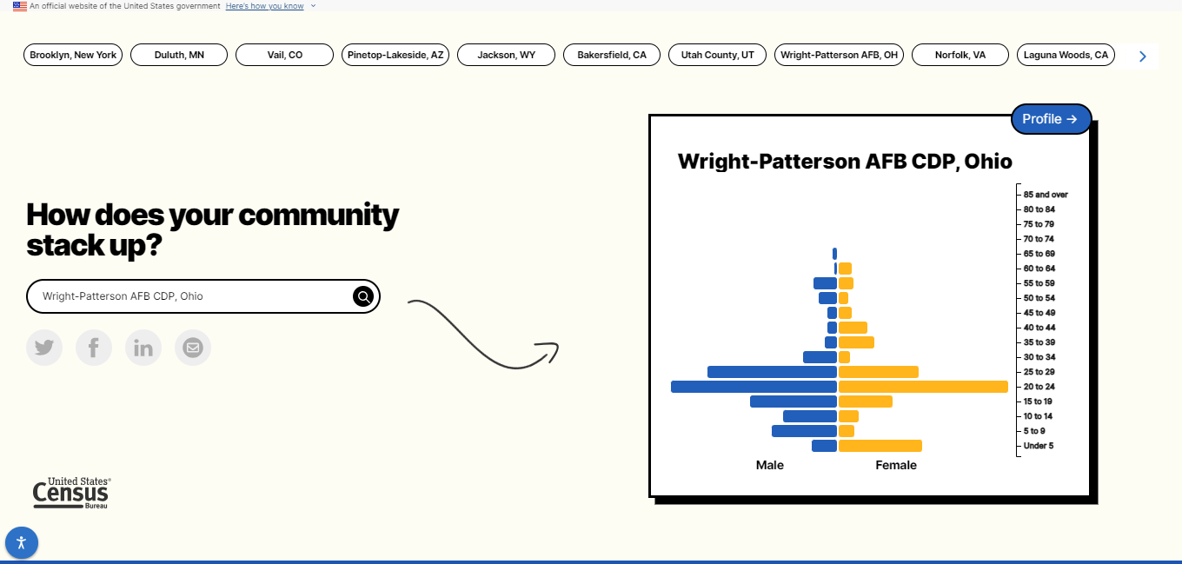
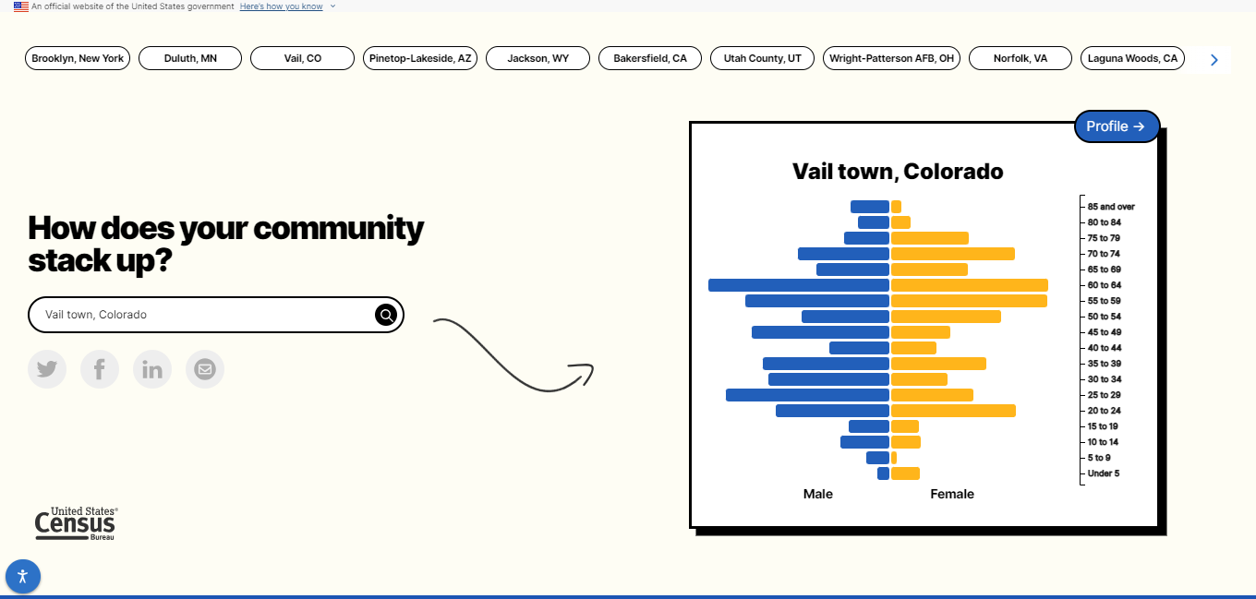
Pop Stories
Overview ends with page where you can select from pre-selected communities or look for one that you are interested in

Slide 24
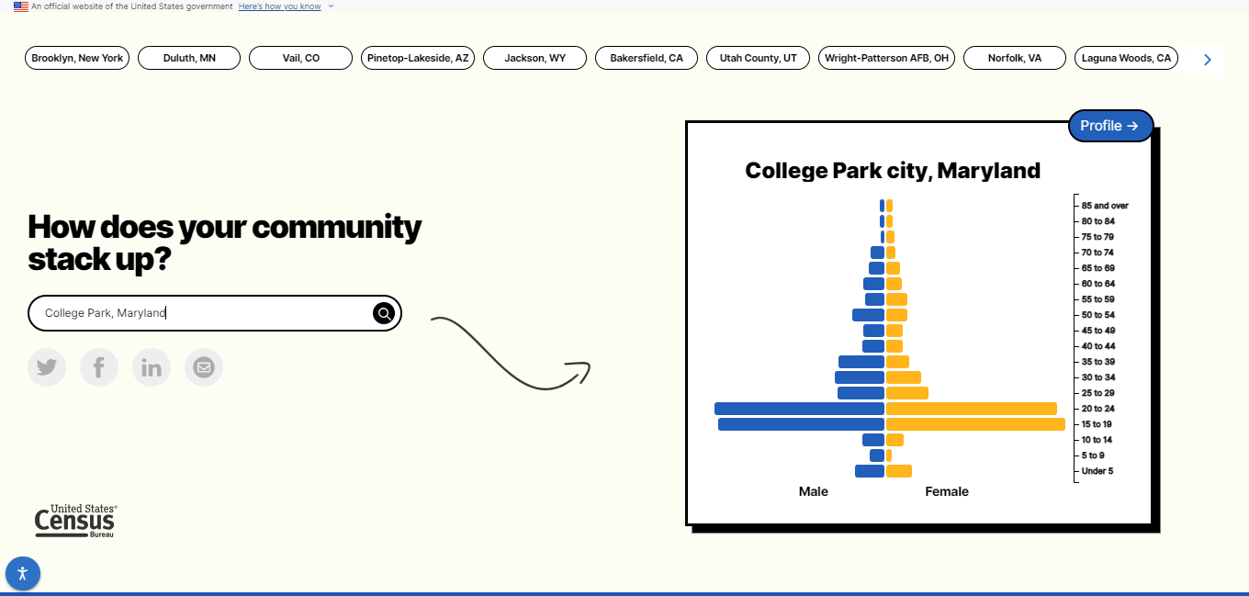
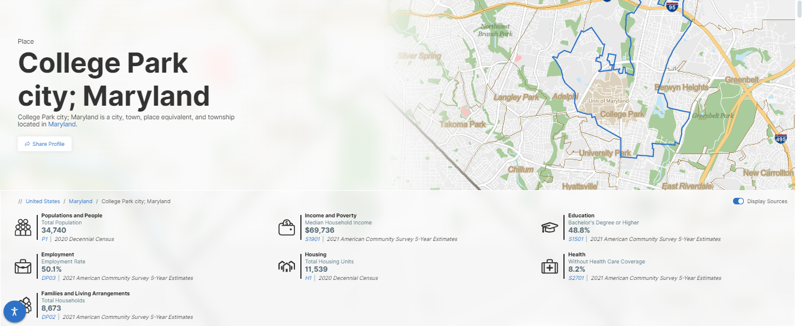
Pop Stories
Look up a community of interest and visit the geographic profile for that community

Slide 25
data.census.gov and the Microdata Access Tool
  Latest Updates to data.census.gov
  Future Updates to data.census.gov
  Finding Detailed DHC-A Data in data.census.gov
    Getting Started: Detailed DHC-A Default Tables
    Selecting Multiple Geographies: Navajo Nation alone or in any combination population for all census tracts in Apache County, AZ
    Selecting Multiple Population Groups: All available Hispanic origin groups in Maricopa County, AZ
  Finding Data in the Microdata Access Tool
    Place of birth by single year of age in Arizona
  Resources

Slide 26
Lasso Tool for Mapping

Slide 27
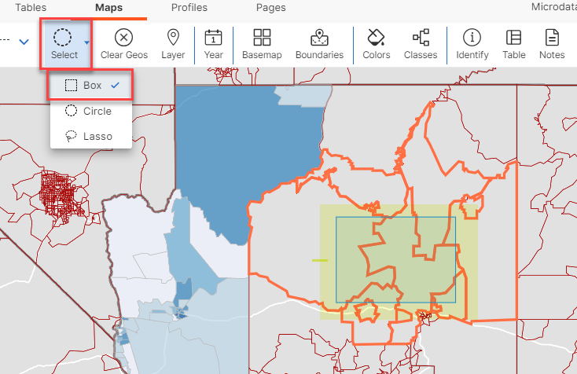
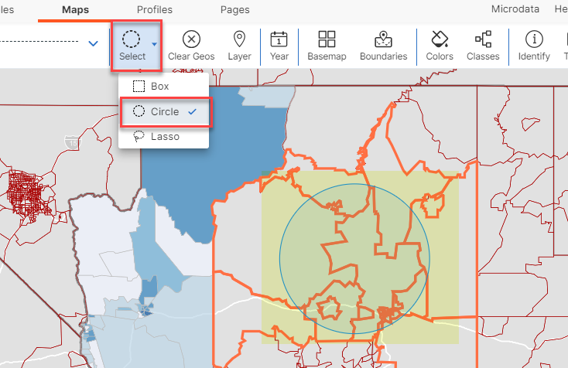
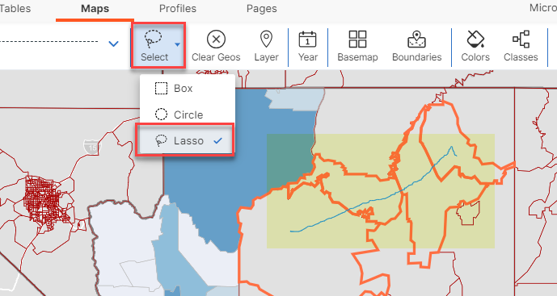
Lasso Tool for Mapping

Slide 28
USA Trade Online (UTO)

Slide 29
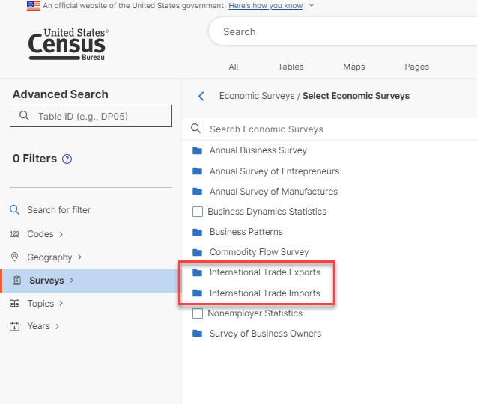
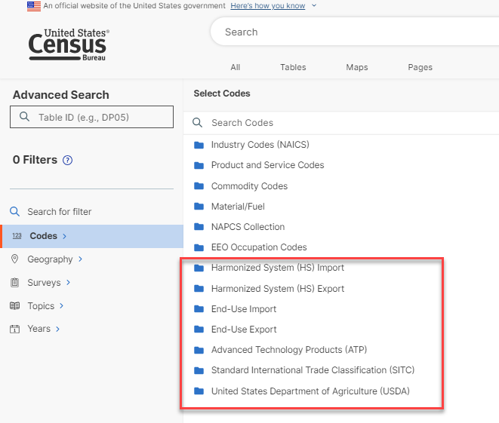
USA Trade Online (UTO)
Adding UTO Surveys and Codesets in preparation for move of UTO app to data.census.gov

Slide 30
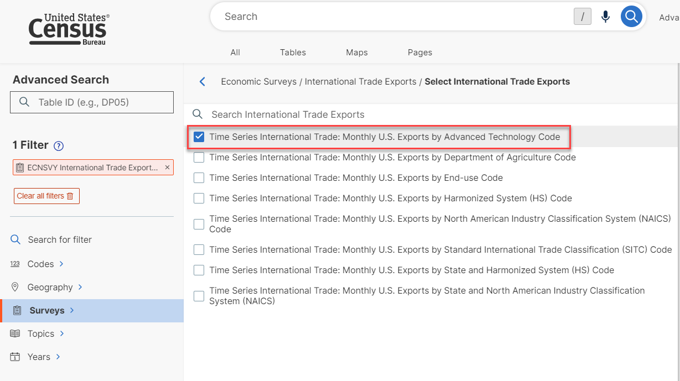
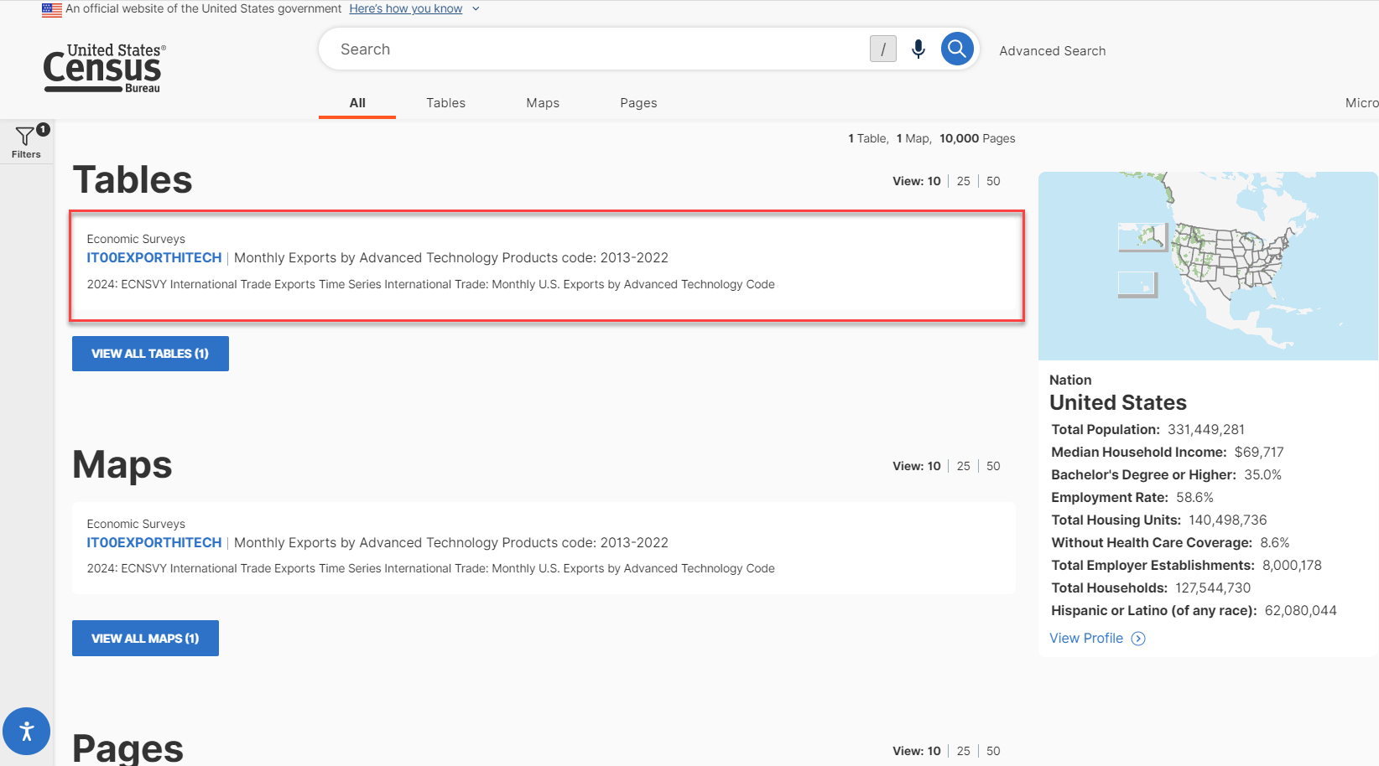
USA Trade Online (UTO)

Slide 31
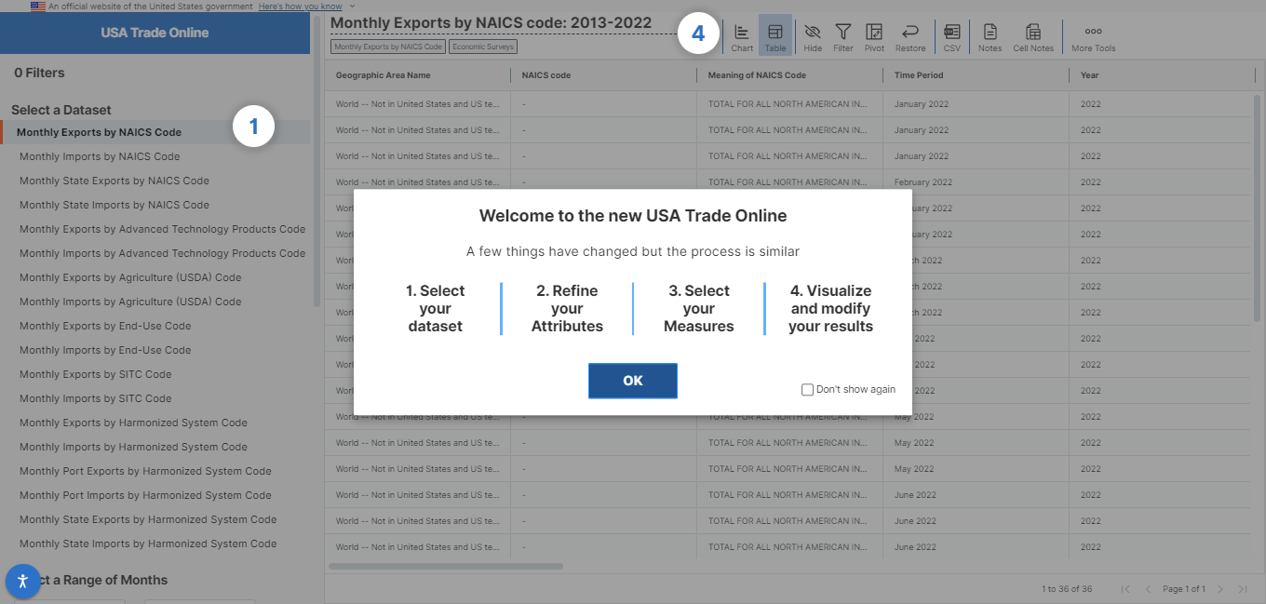
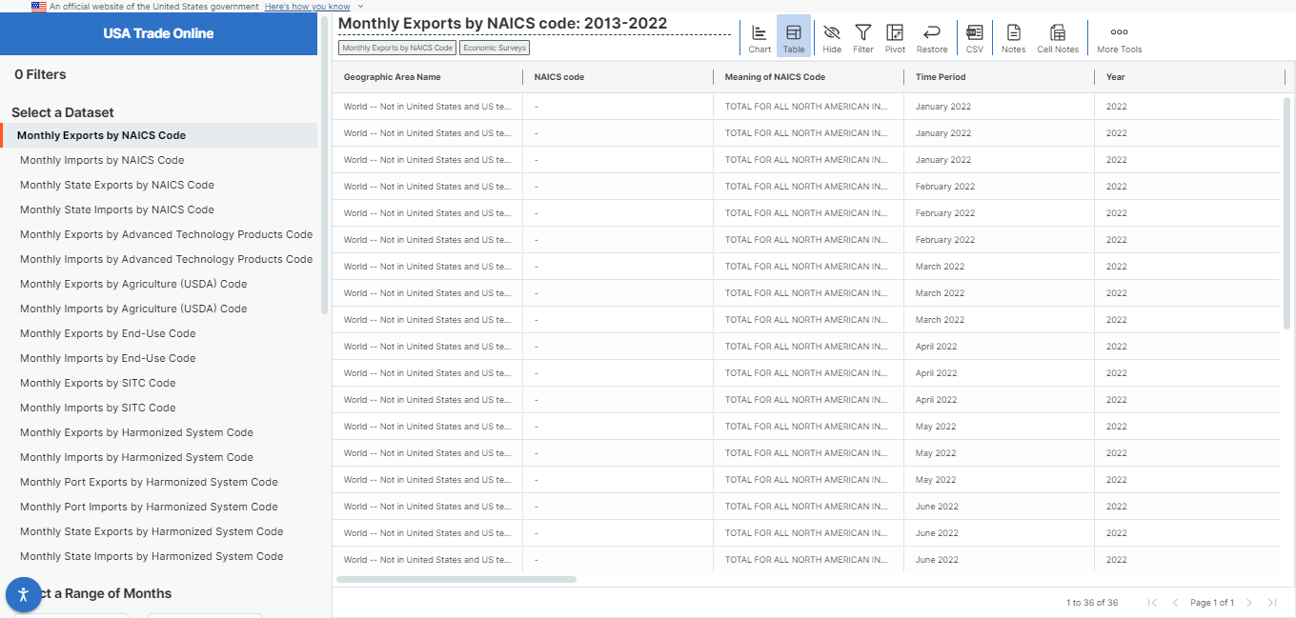
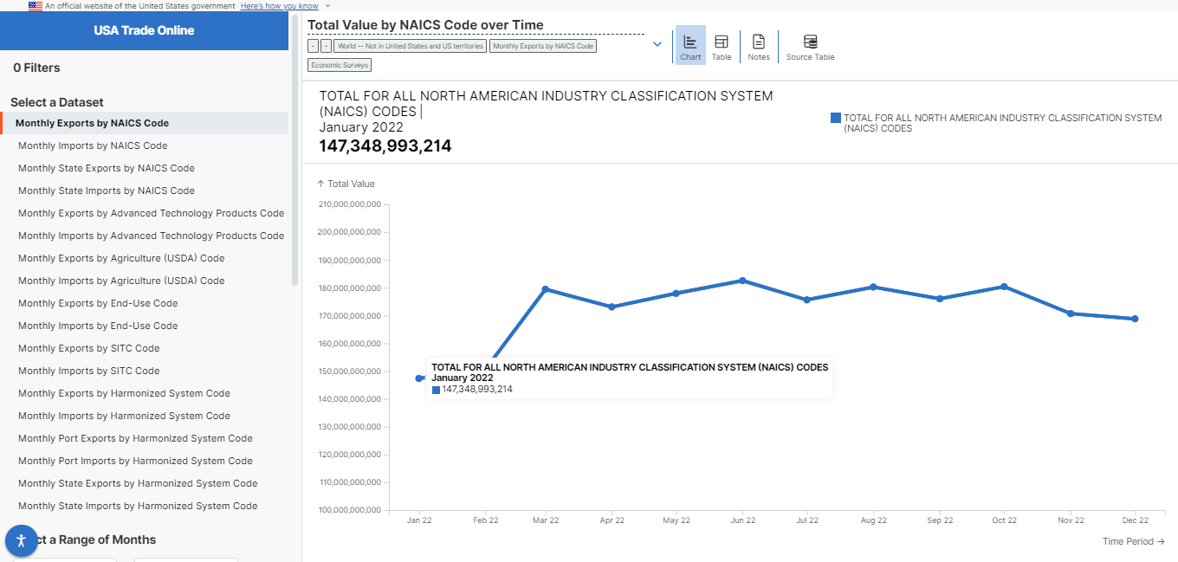
USA Trade Online (UTO)
Continuing work on the UTO app that will eventually move to data.census.gov

Slide 32
New API Interface (CHIPPY)

Slide 33

CHIPPY – Our New API Interface
CHIPPY is a way for data users and developers to discover, search, and access Census data and related information in a more consumable way

Slide 34
Our New API Interface
Our users gave feedback, and we listened. They said:
  Data discovery is difficult
  Need to use multiple endpoints to answer simple queries
  Structure is dataset-focused
  No standardization of content
The new design addresses these concerns
  Discovery is much easier
  Well-organized endpoints
  Standardized, consistent request and response structures

Slide 35
Our New API Interface
API Requests and Responses are Machine and Human-Readable
Potential request structure (for discovery requests):
{
“geoIds”: [“geo1”,”geo2”,…],
“codesets”: {“naics”: [“naics1”,”naics2”,…], “comm”: [“c1”,”c2”,…]}
“topics”: [“topic1”,”topic2”,…],
“tableIds”: [“table1”,”table2”,…],
“datasets”: [“ds1”,”ds2”,…]
}
Potential response structure:
{
"general-info": {}, e.g., service version or response time
"service-messages": {}, e.g., warnings, error messages
"content": {} requested content
}

Slide 36
data.census.gov and the Microdata Access Tool
  Latest Updates to data.census.gov
  Future Updates to data.census.gov
  Finding Detailed DHC-A Data in data.census.gov
    Getting Started: Detailed DHC-A Default Tables
    Selecting Multiple Geographies: Navajo Nation alone or in any combination population for all census tracts in Apache County, AZ
    Selecting Multiple Population Groups: All available Hispanic origin groups in Maricopa County, AZ
  Finding Data in the Microdata Access Tool
    Place of birth by single year of age in Arizona
  Resources

Slide 37
data.census.gov and the Microdata Access Tool
  Latest Updates to data.census.gov
  Future Updates to data.census.gov
  Finding Detailed DHC-A Data in data.census.gov
    Getting Started: Detailed DHC-A Default Tables
    Selecting Multiple Geographies: Navajo Nation alone or in any combination population for all census tracts in Apache County, AZ
    Selecting Multiple Population Groups: All available Hispanic origin groups in Maricopa County, AZ
  Finding Data in the Microdata Access Tool
    Place of birth by single year of age in Arizona
  Resources

Slide 38
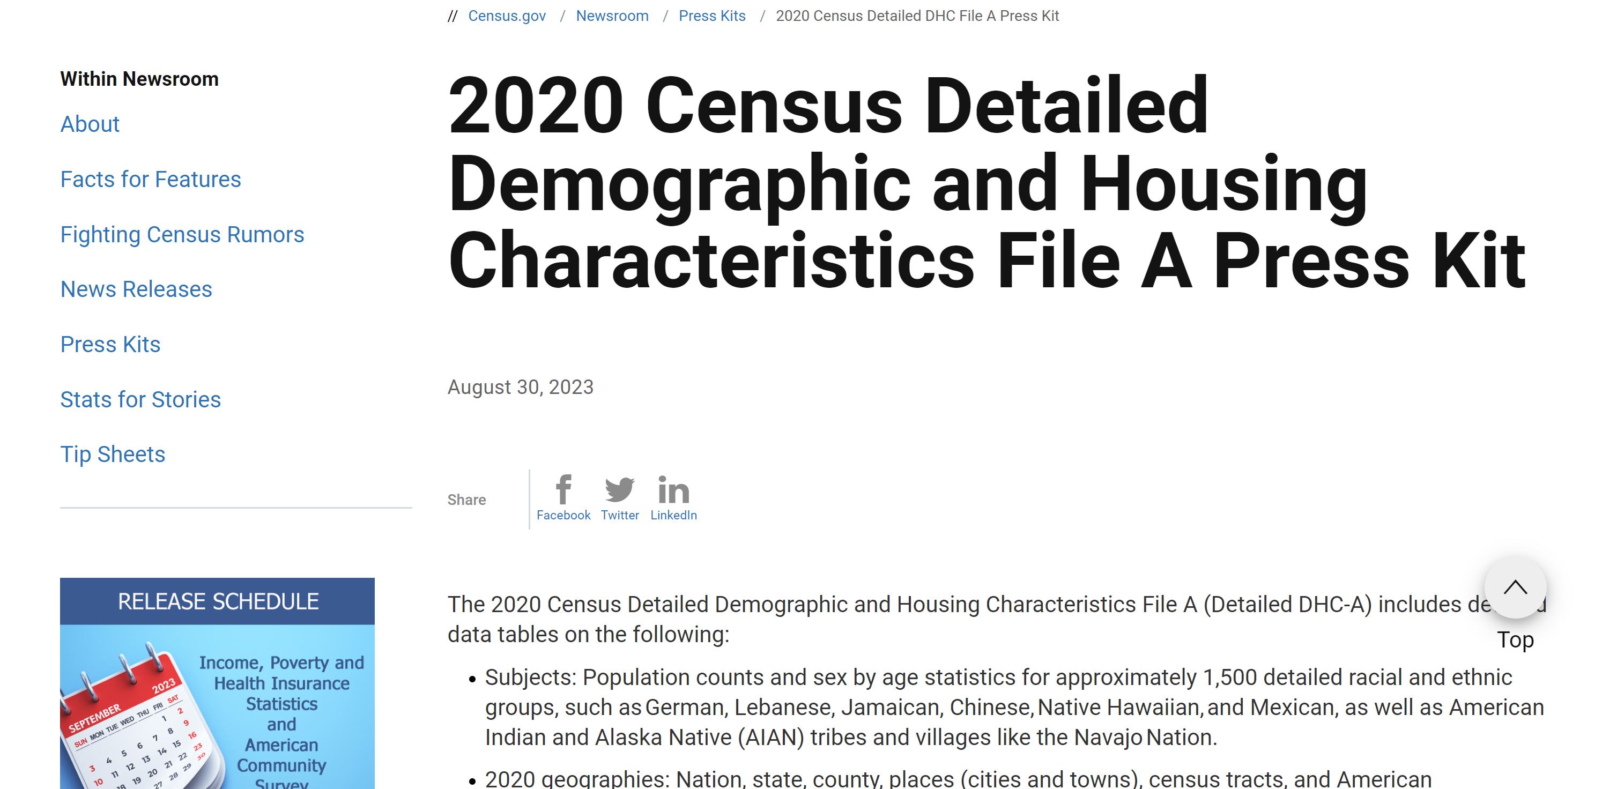

2020 Census Detailed Demographic and Housing Characteristics File A
2020 Census Product Released Sept 21, 2023:
Detailed Demographic and Housing Characteristics File A (DHC-A)
Groups: Approximately 1,500 detailed groups
Detailed racial and ethnic groups
Detailed American Indian and Alaska Native tribes and villages
census.gov/newsroom/press-kits/2023/2020-detailed-dhc-file-a.html

Slide 39
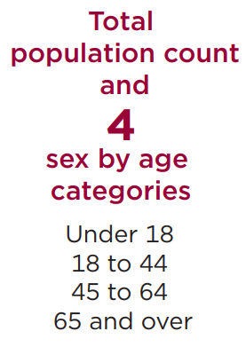
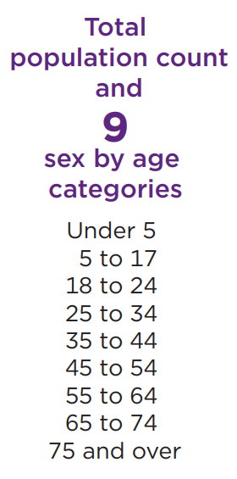
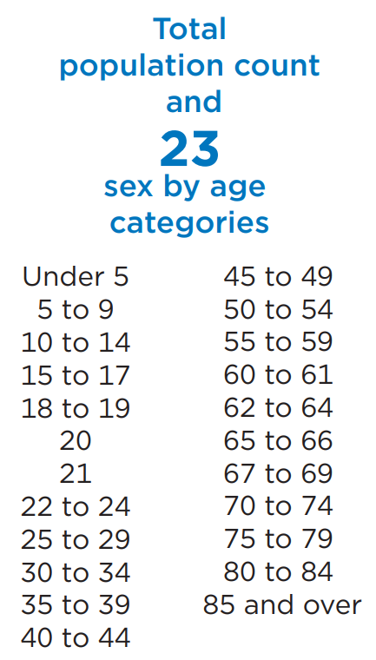
Subjects
Geography
Population counts
Sex-by-age statistics (number of males and females for certain age categories)
Detail depends on the size of the group and the geographic level.​
      Nation
      States
      Counties
      Census tracts
      Places
      American Indian/Alaska Native/Native Hawaiian (AIANNH) areas

Slide 40
Detailed Group Thresholds
Level of Detail | Detailed Groups
 | Nation and State | Substate and AIANNH
Total count only | 0–499 | 22–999
Sex-by-age table – 4 age categories | 500–999 | 1,000–4,999
Sex-by-age table – 9 age categories | 1,000–6,999 | 5,000–19,999
Sex-by-age table – 23 age categories | 7,000+ | 20,000+
Notes:
Groups are assigned the sex-by-age table that corresponds to their total population count 99.9% of the time.
AIANNH is American Indian/Alaska Native/Native Hawaiian areas. Substate includes county, place, and census tract.
Source: U.S. Census Bureau

Slide 41
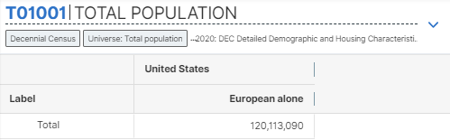
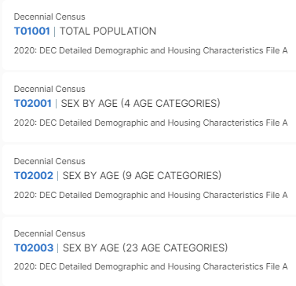



Tables available with the Detailed DHC-A:
Each defaults to a specific population group
Note that each table is available for more than just the single default population group shown
Up to one of the three sex by age tables will have data for any combination of a specific population group and geography. Table availability is based on population thresholds

Slide 42


Ensure Race/Ethnicity Filters Are Compatible with Detailed DHC-A
Tip: Select the year and survey filters before selecting race/ethnicity filters
If you try to select race and ethnicity filters first, you will see all possible options. Filters can change over time:
  Example: “Navajo alone” is for 2000 Census data; “Navajo Nation alone” is for 2020 Census data

Slide 43
data.census.gov and the Microdata Access Tool
  Latest Updates to data.census.gov
  Future Updates to data.census.gov
  Finding Detailed DHC-A Data in data.census.gov
    Getting Started: Detailed DHC-A Default Tables
    Selecting Multiple Geographies: Navajo Nation alone or in any combination population for all census tracts in Apache County, AZ
    Selecting Multiple Population Groups: All available Hispanic origin groups in Maricopa County, AZ
  Finding Data in the Microdata Access Tool
    Place of birth by single year of age in Arizona
  Resources

Slide 44

Open the Filter Panel
Select Advanced Search to open the filter panel

Slide 45

Select Year: 2020
Select 2020 under the Years heading

Slide 46

Select Survey: Detailed Demographic and Housing Characteristics File A
Select Decennial Census under the Surveys heading
Select Detailed Demographic and Housing Characteristics File A

Slide 47



Select Geography
Select Census Tract under the Geography heading
Select Arizona
Select Apache County, Arizona
Select All Census Tracts within Apache County, Arizona

Slide 48

Select Population Group
Select Race and Ethnicity under the Topics heading
Select American Indian and Alaska Native

Slide 49



Select Population Group
Select Detailed American Indian and Alaska Native Alone or in Any Combination → American Indian alone or in any combination → Type ‘Navajo’ in the search box and check the box for Navajo Nation alone or in any combination

Slide 50

Run Search
Verify filters and click Search

Slide 51


View Results: Total Population and Age and Sex
Click Tables at the top
View T01001 | Total Population
Table T02001 | Sex by Age (4 Age Categories) is provided because the Navajo Nation population in some tracts in Apache County falls within 1,000-4,999, which is the threshold for detailed groups to receive this table for substate geographies

Slide 52


Navigate to Map
Navigate to the map tab
Click Maps at the top
Click the table that contains the data you want to map, and then close the results panel so you can see the map across your full screen
Click the variables toolbar at the top of the map

Slide 53

Select Data Variable
Confirm selection is Total
Confirm dimension is set to Navajo Nation alone or in any combination

Slide 54

View Map
Click on the tracts with the darkest shade of blue to see which areas have the highest Navajo Nation alone or in any combination population

Slide 55
Detailed Group Thresholds:
Navajo Nation Population for Census Tracts in Apache County = 1,000-4,999
Level of Detail | Detailed Groups
 | Nation and State | Substate and AIANNH
Total count only | 0–499 | 22–999
Sex-by-age table – 4 age categories | 500–999 | 1,000–4,999
Sex-by-age table – 9 age categories | 1,000–6,999 | 5,000–19,999
Sex-by-age table – 23 age categories | 7,000+ | 20,000+
Notes:
Groups are assigned the sex-by-age table that corresponds to their total population count 99.9% of the time.
AIANNH is American Indian/Alaska Native/Native Hawaiian areas. Substate includes county, place, and census tract.
Source: U.S. Census Bureau

Slide 56
data.census.gov and the Microdata Access Tool
  Latest Updates to data.census.gov
  Future Updates to data.census.gov
  Finding Detailed DHC-A Data in data.census.gov
    Getting Started: Detailed DHC-A Default Tables
    Selecting Multiple Geographies: Navajo Nation alone or in any combination population for all census tracts in Apache County, AZ
    Selecting Multiple Population Groups: All available Hispanic origin groups in Maricopa County, AZ
  Finding Data in the Microdata Access Tool
    Place of birth by single year of age in Arizona
  Resources

Slide 57
Open the Filter Panel
Select Advanced Search to open the filter panel

Slide 58
Select Year: 2020
Select 2020 under the Years heading

Slide 59
Select Survey: Detailed Demographic and Housing Characteristics File A
Select Decennial Census under the Surveys heading
Select Detailed Demographic and Housing Characteristics File A

Slide 60


Select Geography
Select County under the Geography heading
Select Arizona
Select Maricopa County, Arizona

Slide 61



Select Population Group
Select Race and Ethnicity under the Topics heading
Select Hispanic or Latino
Select Detailed Hispanic or Latino
Check the box for All available detailed Hispanic Origins

Slide 62

Run Search
Verify filters and click Search

Slide 63

View Results: Total Population
Click Tables at the top
View T01001 | Total Population
The table contains data for all selected detailed groups with at least 22 people in Maricopa County, and regional groups with at least 94 people

Slide 64

View Results: Age and Sex
Each population group may appear in one of the three sex by age tables based on population thresholds for the group in Maricopa County

Slide 65
Regional Group Thresholds
Also available: Regional race and ethnicity groups, such as European, Middle Eastern or North African, Caribbean, Sub-Saharan African, American Indian, Polynesian, South American, etc.
Level of Detail | Regional groups
 | Nation and State | Substate
Total count only | 0–4,999 | 94–4,999
Sex-by-age table – 4 age categories | 5,000–19,999 | 5,000–19,999
Sex-by-age table – 9 age categories | 20,000–149,999 | 20,000–149,999
Sex-by-age table – 23 age categories | 150,000+ | 150,000+
Notes:
Groups are assigned the sex-by-age table that corresponds to their total population count 99.9% of the time.
Regional groups are not available for AIANNH areas except when postprocessing was applied.
Substate includes county, place, and census tract.
Source: U.S. Census Bureau

Slide 66


Iterations List: Regional and Detailed Groups
Iterations list provides a listing of population groups
Regional groups are shown with an asterisk
Detailed groups are shown without asterisks or boldface
https://www2.census.gov/programs-surveys/decennial/2020/technical-documentation/complete-tech-docs/detailed-demographic-and-housing-characteristics-file-a/2020-census-hispanic-origin-and-race-iterations-list.xlsx

Slide 67
data.census.gov and the Microdata Access Tool
  Latest Updates to data.census.gov
  Future Updates to data.census.gov
  Finding Detailed DHC-A Data in data.census.gov
    Getting Started: Detailed DHC-A Default Tables
    Selecting Multiple Geographies: Navajo Nation alone or in any combination population for all census tracts in Apache County, AZ
    Selecting Multiple Population Groups: All available Hispanic origin groups in Maricopa County, AZ
  Finding Data in the Microdata Access Tool
    Place of birth by single year of age in Arizona
  Resources

Slide 68
Microdata = PUMS Files
Public Use Microdata
Anonymized
No personally identifiable information
Edits to protect confidentiality
Accessible
data.census.gov/mdat
Application Programming Interface (API)
Download through FTP sites
Individual Responses
Must be tabulated and weighted by user

Slide 69





What’s the difference between data.census.gov and Microdata Access?
data.census.gov
Estimates are created using individual records that are only available to Census program area staff
Microdata Access (internally known as MDAT)
Estimates are created using a sample of individual records that have been processed for use by the public
Internal file
Edits
applied to protect confidentiality
Survey Responses (individual records)
Public Use file

Slide 70
What are the pros and cons of using data.census.gov and Microdata Access?
Data.census.gov using Internal file
Microdata Access using Public Use file
Pros and Cons of Using Tables found in data.census.gov
Pros: Provides more precise estimates Wider range of datasets Fewer limitations to available geographies No in-depth knowledge of variables required | Cons: Limited to crosstabulations and tables that are predetermined by data providers Limited ability to customize tables
Pros and Cons of Creating Tables in Microdata Access
Pros: Provides custom estimates when a pre-tabulated Census table is not available More historical data available Includes datasets not available in data.census.gov | Cons: Limited geographies Provides less precise estimates Requires in-depth knowledge of variables No margins of error provided

Slide 71


What’s the difference between tabulated data and microdata?
data.census.gov
Aggregated tables for a geography:
“In 2019 in Maryland, approximately 121,160 males worked in computer and mathematical occupations.”
Microdata Access (MDAT)
Microdata (a set of edited survey responses):
“This male in Maryland is a web developer.”
Tabulated data
Microdata

Slide 72




Data Dictionaries
American Community Survey
https://www.census.gov/programs-surveys/acs/microdata/documentation.html
Current Population Survey Annual Social and Economic Supplement (CPS ASEC)
https://www.census.gov/data/datasets/2022/demo/cps/cps-asec-2022.html

Slide 73



Data Dictionaries
American Community Survey
https://www.census.gov/programs-surveys/acs/microdata/documentation.html
The ACS PUMS data dictionary is broken out into different sections of variables, including basic variables, housing unit variables, and person variables.

Slide 74

Data Dictionaries
American Community Survey
https://www.census.gov/programs-surveys/acs/microdata/documentation.html
Find all the variables that are available in the PUMS dataset for any given year.
The dictionary will give you the name of the variable, whether it’s a character or numeric variable, the length of the variable, a brief description of the variable, and the possible response options or recoded values.

Slide 75
data.census.gov and the Microdata Access Tool
  Latest Updates to data.census.gov
  Future Updates to data.census.gov
  Finding Detailed DHC-A Data in data.census.gov
    Getting Started: Detailed DHC-A Default Tables
    Selecting Multiple Geographies: Navajo Nation alone or in any combination population for all census tracts in Apache County, AZ
    Selecting Multiple Population Groups: All available Hispanic origin groups in Maricopa County, AZ
  Finding Data in the Microdata Access Tool
    Place of birth by single year of age in Arizona
  Resources

Slide 76

Problem: We need detailed place of birth for single years of age for Arizona, but none of the published ACS tables have this cross of characteristics available for detailed places of birth and single years of age
Solution: Use Microdata Access (MDAT)

Slide 77

Visit Microdata Access at data.census.gov/mdat
data.census.gov/mdat

Slide 78

Choose Dataset and Vintage:
  Dataset – ACS 5-Year Estimates – Public Use Microdata Sample
  Vintage – 2021
  Click Next in the lower right

Slide 79

Search for Variables: Use the search box below “Variable” or “Label” to find your variables of interest

Slide 80

Select variable for Age:
  Type “AGEP” in the Variable search box or type “Age” in the label search box
  Check the box to the left of AGEP to add the variable to your data cart
  Notice the message at the top of the screen saying you will need to create your own categories (or recodes) for this variable if you want it shown in the table. (You will do this action in the Data Cart)

Slide 81

Select variable for the Place of Birth:
  Type “POBP” in the Variable search box or type “birth” in the label search box
  Check the box to the left of POBP to add the variable to data cart

Slide 82

Select geography:
  Move to the Select Geographies tab
  Click State and click on Arizona

Slide 83

Categorize (recode) your variable:
  Move to the Data Cart tab
  Click the AGEP variable on the left
  Click Create Custom Group to begin specifying your age groups (e.g. single years of age)

Slide 84

Categorize (recode) your variable:
  Check the box next to Add to Group to add both categories to the recode
  Click on Auto Group

Slide 85


Categorize (recode) your variable:
  Confirm that the Start value is ‘1’, the End value is ‘99’, and the Groups of value is ‘1’
  Click Auto Group. This will automatically create each year of age as its own group.

Slide 86

Categorize your variable:
  Click the POBP variable on the left
  We want data specifically for people who were born in the Philippines
  Uncheck the box next to Include in Universe

Slide 87

Categorize your variable:
  Click into the box for Response Label and enter ‘Philippines’
  Check the box next to the response category of ‘Philippines’

Slide 88

View variable placement in the default table layout:
  Move to the Table Layout tab
  Columns/Rows – Variables will be shown in the table. By default, the table is providing the average age with place of birth in the rows.

Slide 89

Edit Table Layout:
  Move Place of Birth to Columns:
    Click, hold and drag POBP on the left side of the page up to the columns heading. This will give you a table layout that includes the place of birth category as the column.

Slide 90

Edit Table Layout:
  Move Age Recode to Rows:
    Click, hold and drag AGEP_RC1 on the left side of the page up to the rows heading. This will give you a table layout that includes the age categories that were created as the rows.

Slide 91

Choose type of values in table cells
  Change the “Value in table cells” option from Average of Age (AGEP) to Count. This will give you data for the total number of people within the requested categories.

Slide 92

Confirm Table Layout:
  Confirm table layout and click View Table in the lower right

Slide 93

View Table
Note that the site automatically chooses a weight for you. You do have the option to change the weight if you want.

Slide 94

Sort Table:
  Click the column header to sort the column in ascending or descending order

Slide 95
data.census.gov and the Microdata Access Tool
  Latest Updates to data.census.gov
  Future Updates to data.census.gov
  Finding Detailed DHC-A Data in data.census.gov
    Getting Started: Detailed DHC-A Default Tables
    Selecting Multiple Geographies: Navajo Nation alone or in any combination population for all census tracts in Apache County, AZ
    Selecting Multiple Population Groups: All available Hispanic origin groups in Maricopa County, AZ
  Finding Data in the Microdata Access Tool
    Place of birth by single year of age in Arizona
  Resources

Slide 96



data.census.gov Resource Page

Slide 97


Latest & Upcoming Releases

Slide 98

Developmental & Latest Updates

Slide 99



Guidance for Data Users

Slide 100




Guidance for Data Users

Slide 101



Guidance for Data Users

Slide 102


Email Updates
Get data.census.gov updates delivered to your inbox!
Sign up for email updates:
https://public.govdelivery.com/accounts/USCENSUS/signup/15450

Slide 103

Stay Connected
data.census.gov Resources page:
census.gov/data/what-is-data-census-gov.html
Feedback: Email comments to census.data@census.gov

