Slide 1



2022 Economic Census Update
Arizona State Data Center Annual Network Meeting
October 26, 2023
Chuck Brady – U.S. Census Bureau
Chief, Respondent Outreach & Promotion Branch
Economic Management Division
NJ SDC Annual Meeting | October 5, 2023

Slide 2

Agenda
Introduction – Census Bureau Surveys
What is the Economic Census?
2022 Economic Census Data
Data Stories Campaign
Annual Integrated Economic Survey
Q&A
NJ SDC Annual Meeting| October 5, 2023 | 2

Slide 3

Census Bureau Surveys

Slide 4



The Census Bureau measures more than people
Most people know that the U.S. Census Bureau measures the population every 10 years.
But most people don’t know that we also measure the economy.
  In fact, the Census Bureau conducts more than 30 economic surveys each year.
This includes the Economic Census which measures U.S. businesses every 5 years.
U.S. Census Bureau Partner Briefing | 4
NJ SDC Annual Meeting| October 5, 2023 | 4

Slide 5

Census Economic Programs
Census Bureau economic programs are a key source for official statistics:
NEW High Frequency data
Monthly and quarterly small sample surveys provide the most TIMELY data available
Annual surveys have larger samples and provide the most up-to-date TREND data available
Every 5 years, the Censuses measure businesses and governments and provide the most COMPREHENSIVE data available
Plus, FOUNDATIONAL administrative data from the Business Register to supplement or produce additional economic products
High Frequency
Monthly & Quarterly
Annual Surveys
Censuses – Every 5 Years
Administrative Data
NJ SDC Annual Meeting| October 5, 2023 | 5

Slide 6

What is the Economic Census?

Slide 7

The Economic Census
The official measure of U.S. business and the economy
The 2022 Economic Census collection is concluding
  Companies report their 2022 year-end numbers
  Data release is planned for early 2024 through 2026
Response is mandatory under Title 13, U.S. Code
  The Census Bureau is also required by law to keep information private and secure
  Information is used for statistical purposes only
Results will be free and available online
NJ SDC Annual Meeting| October 5, 2023 | 7

Slide 8
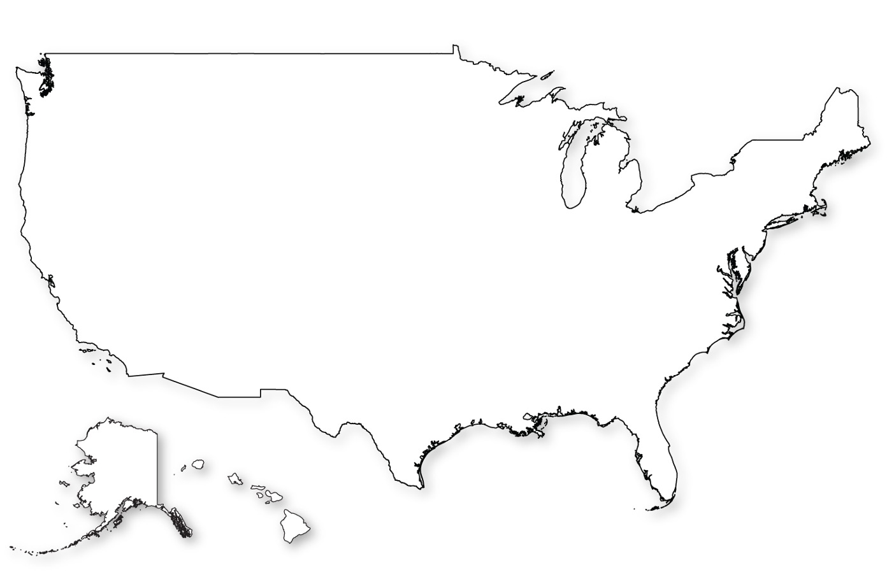
Note: Most companies do not receive the Economic Census
There are more than
~ 30 million businesses in the United States
Only businesses with employees, and
Only a sample of smaller businesses are required to respond.
~ 8 million are employer business establishments
~ 4 million receive the Economic Census
NJ SDC Annual Meeting| October 5, 2023 | 8

Slide 9

Information Required
The Economic Census asks for the following information for each business location:
Employer Identification Number
Physical location
Primary business activity
Sales, receipts, or revenue
Employment and payroll
Industry-specific questions
NJ SDC Annual Meeting| October 5, 2023 | 9
ASBDC | September 6, 2023 | 9
ASBDC | September 6, 2023 | 9

Slide 10
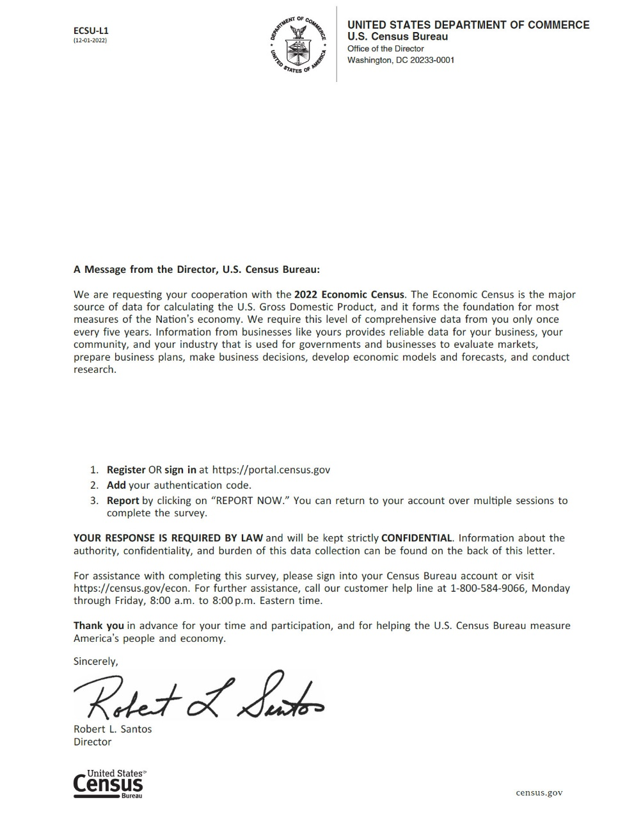
2022 Economic Census - Status
Official letters were mailed out in January/February
  Respondents were instructed to set up an online account on secure website to complete survey. Response URL is portal.census.gov
Due Date was March 15
Companies requested and received time extensions
Follow-ups have taken place over the summer and fall
Response rates are tracking around the same as the 2017 Economic Census
We are still collecting response…
NJ SDC Annual Meeting| October 5, 2023 | 10
ASBDC | September 6, 2023 | 10

Slide 11
How you can help response
Use key messaging where applicable in support of local businesses
  Not every business received an Economic Census
  Response is required by law
  Estimates are acceptable
  Direct to census.gov/econ
Utilize census data and demonstrate how to do so
  Census Business Builder
  Data.Census.Gov
NJ SDC Annual Meeting| October 5, 2023 | 11

Slide 12

2022 Economic Census Data

Slide 13
Accelerated Data Release Plan
Series | Description | Planned Release
First Look Report | General statistics data at the 2 – 3 digit NAICS level | March 2024
Island Area Series | Guam, American Samoa, Northern Mariana Islands U.S. Virgin Islands Puerto Rico | June 2024 July 2024 June 2025
Geographic Area Series | General statistics data at the U.S., State, Metro Area, County, and Place level; Complete state released | March 2025
Bridge/Comparative | Industries whose NAICS changed between 2022 and 2017/All 2-6 2022 NAICS for 2022 and 2017 | June 2025
North American Product Classification System (NAPCS) Tables | Product details for industries | September 2025
Misc. Subjects | Trade specific, on a flow basis | Last release by March 2026
NJ SDC Annual Meeting| October 5, 2023 | 13

Slide 14
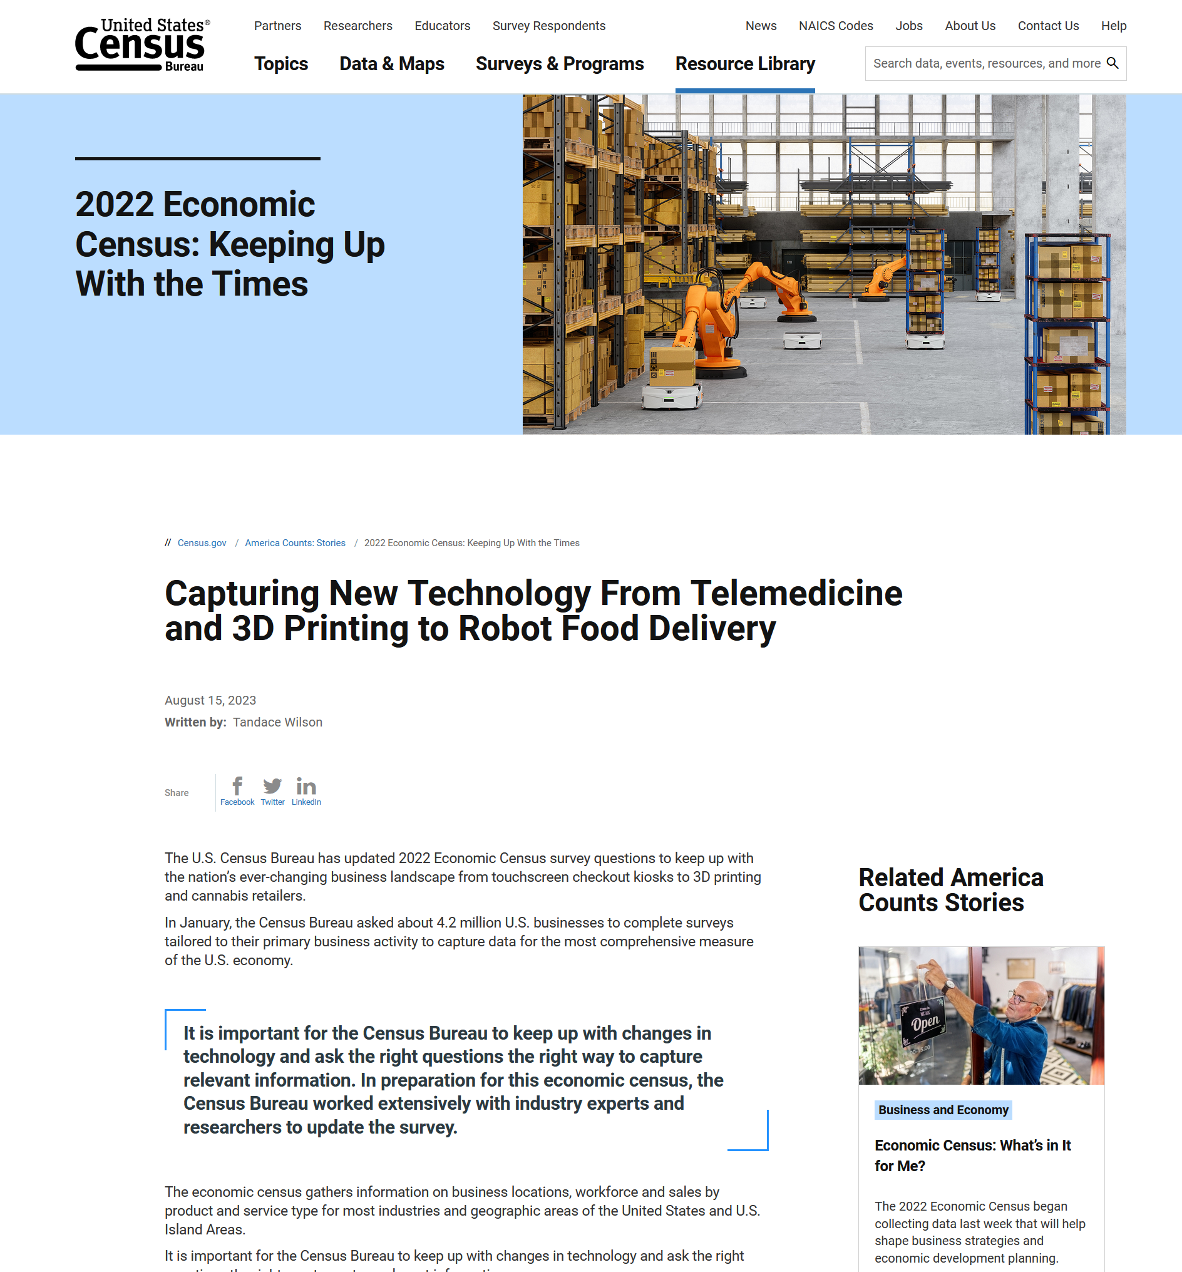
New Content - Measure the changing economy
Topics
  Business Technologies
    Touchscreens and Kiosks
    Additive manufacturing (3D Printing)
    Radio-Frequency Identification (RFID)
    Industrial and service robots
  Remanufacturing
  Telemedicine
NAPCS
  Cannabis (also KOB)
  Cryptocurrency
  Electric Vehicles
NJ SDC Annual Meeting| October 5, 2023 | 14

Slide 15

New Content - Industry Expansion
New Industry Subsectors
1151 – Support Activities for Crop Production
1152 – Support Activities for Animal Production
2022 Focus for NAICS 115
Frame coverage
Basic data items
  Primary business activity
  Receipts
  Employment, payroll
NJ SDC Annual Meeting| October 5, 2023 | 15

Slide 16

“Data Stories” Campaign

Slide 17
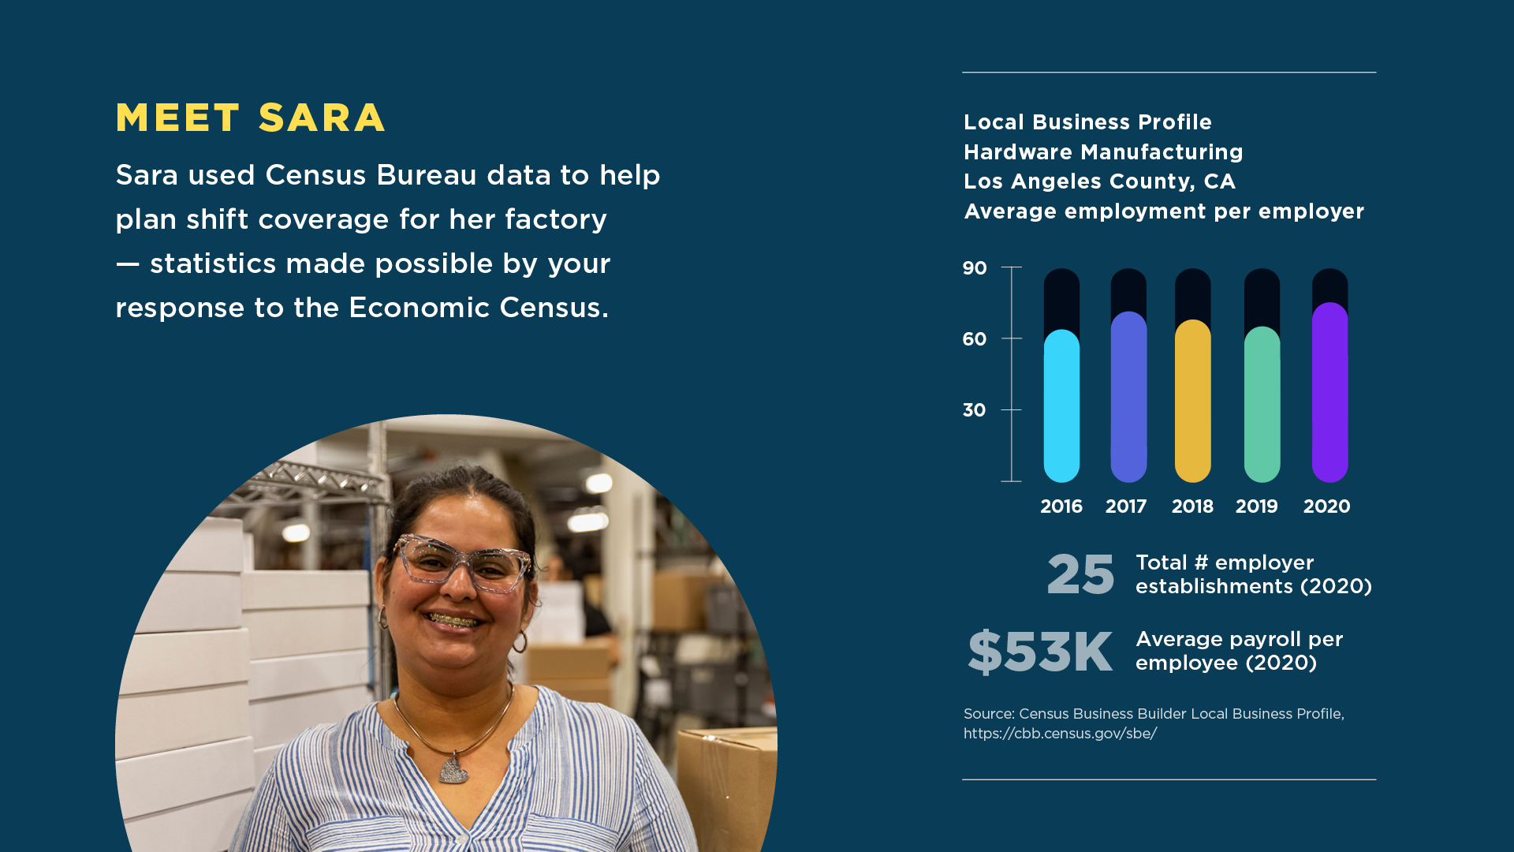
Your Response Makes a Difference

Slide 18
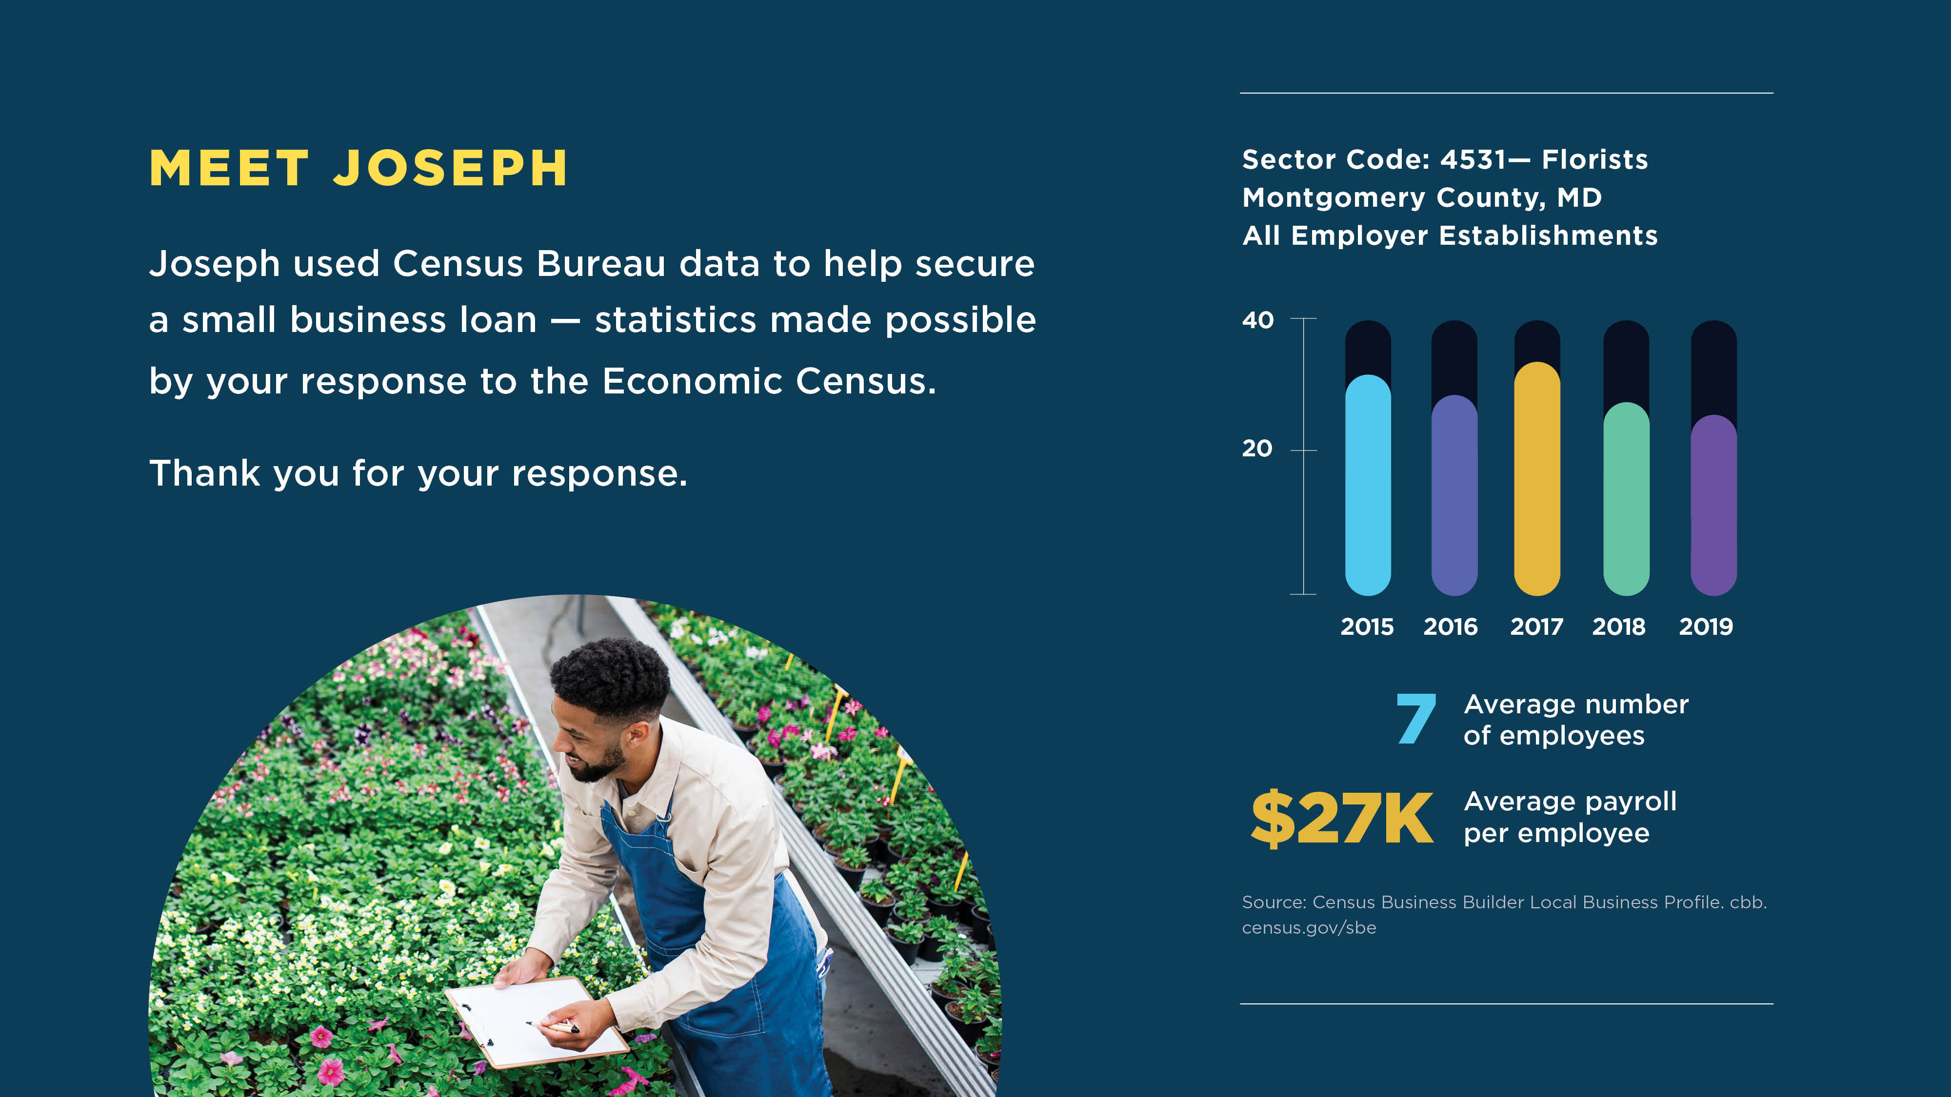
Your Response Makes a Difference

Slide 19
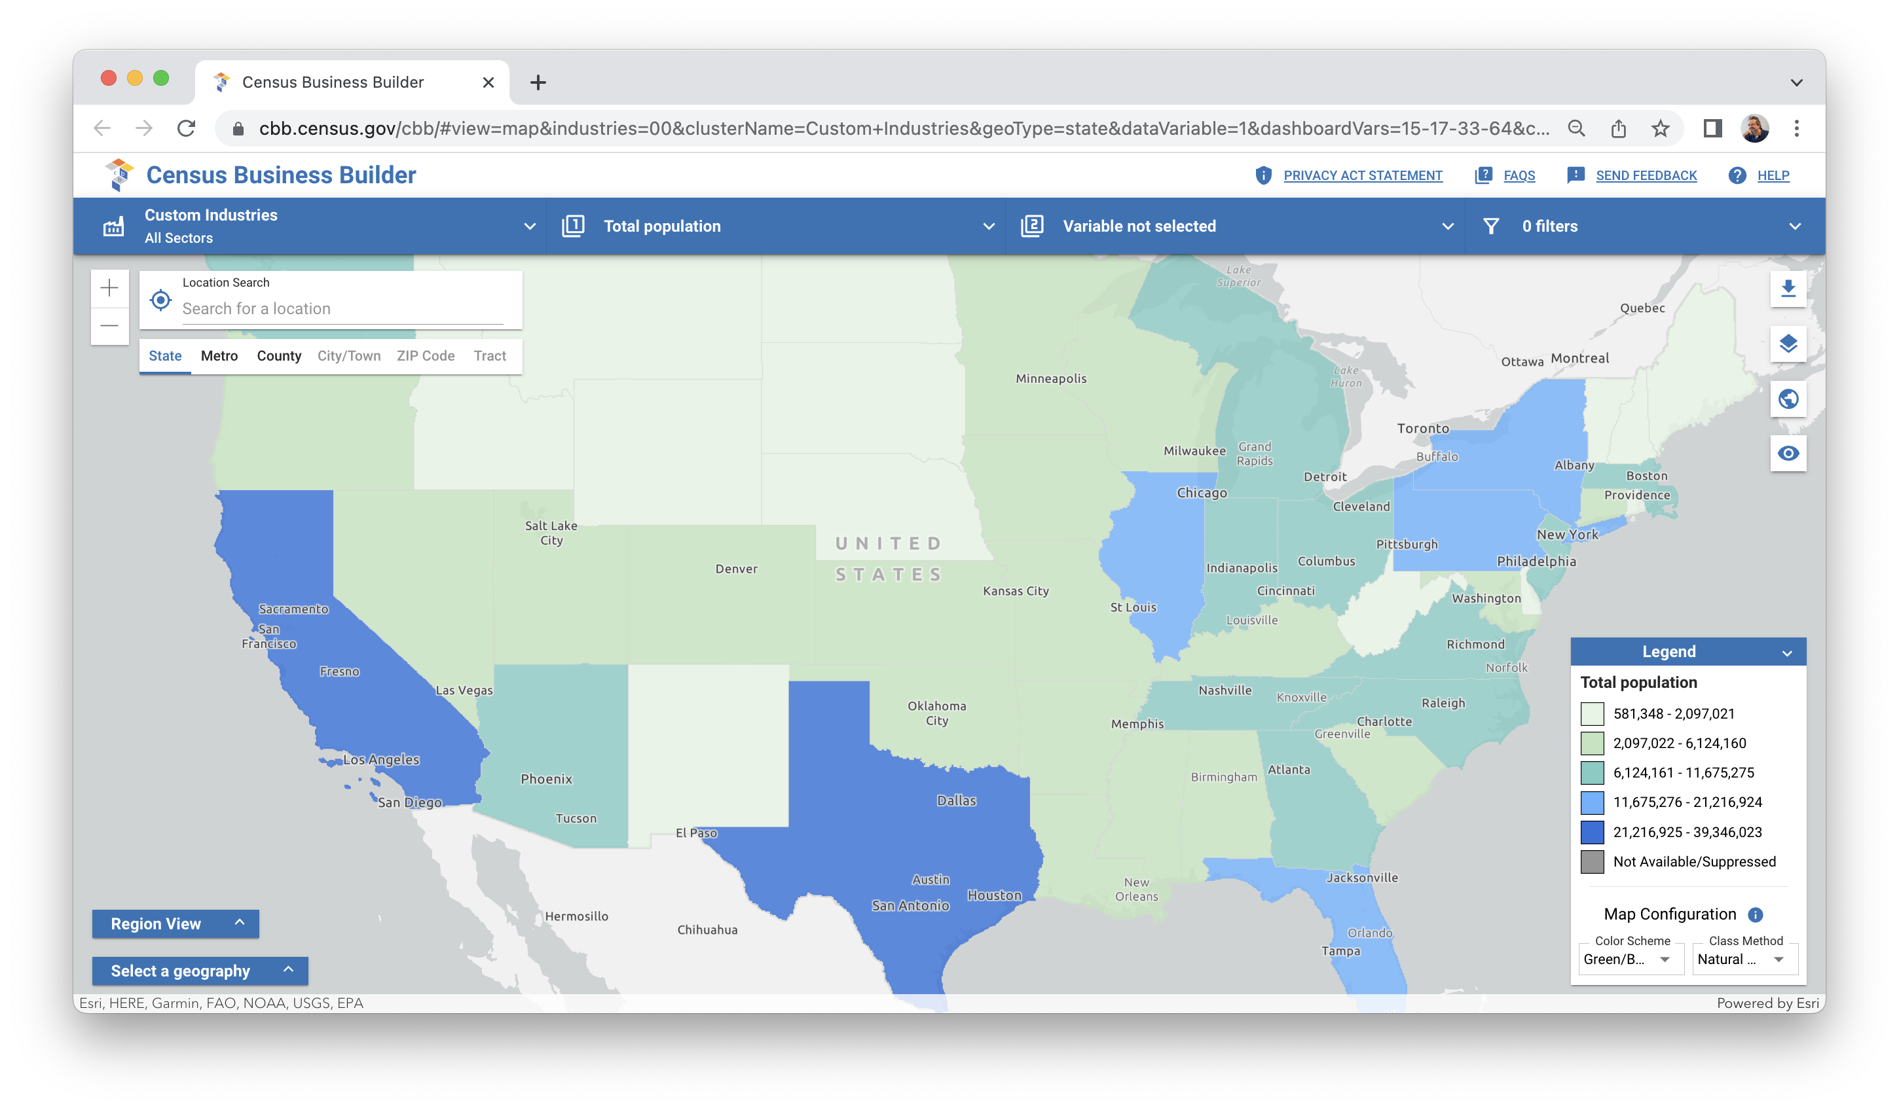
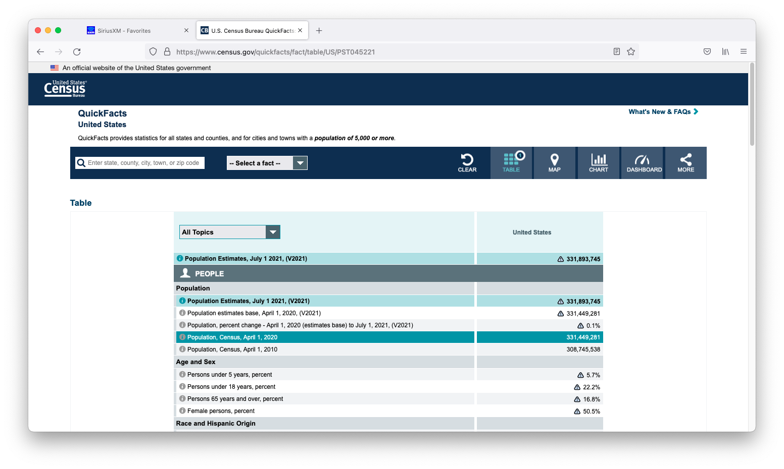
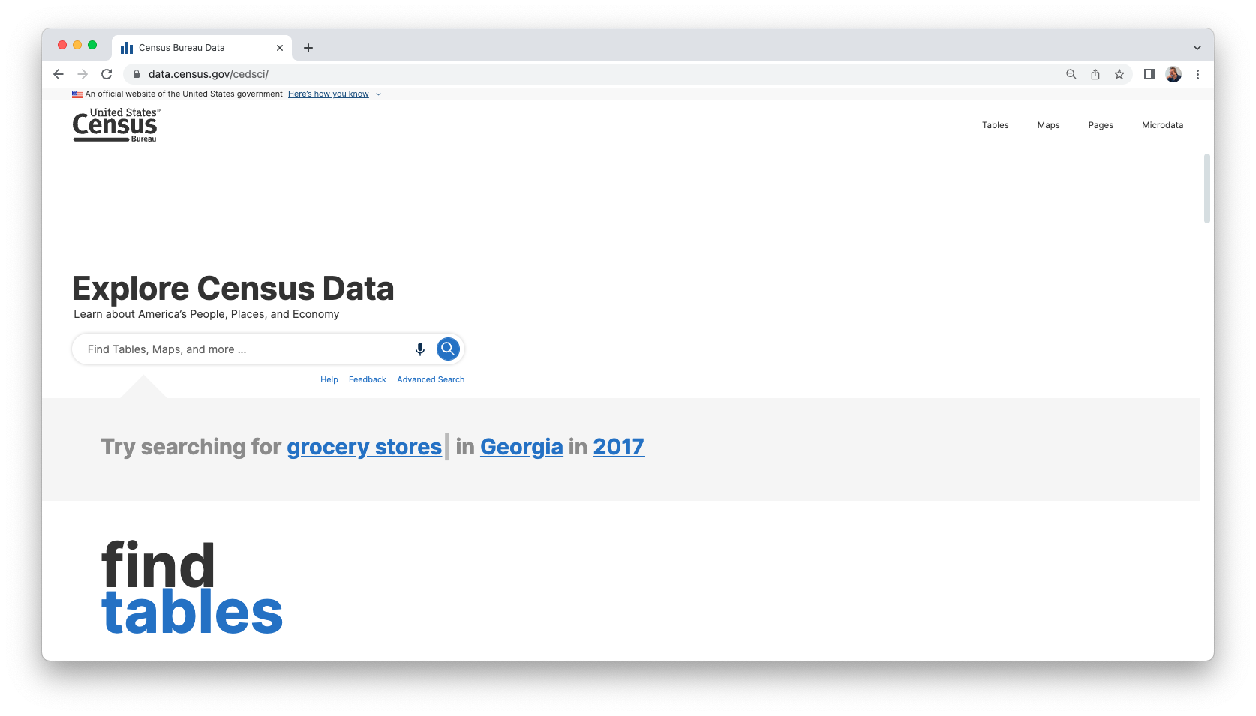

Census Bureau Data Tools – Free and Available Online
Data by industry and geography
Data by geography
Explore all Census Bureau data
cbb.census.gov
census.gov/quickfacts
data.census.gov
LAACC Small Business Strong Webinar | 03.22.2023 | 19

Slide 20
“Data Stories” Campaign
Phase Two – Data Awareness & Usage [IN DEVELOPMENT]

Slide 21
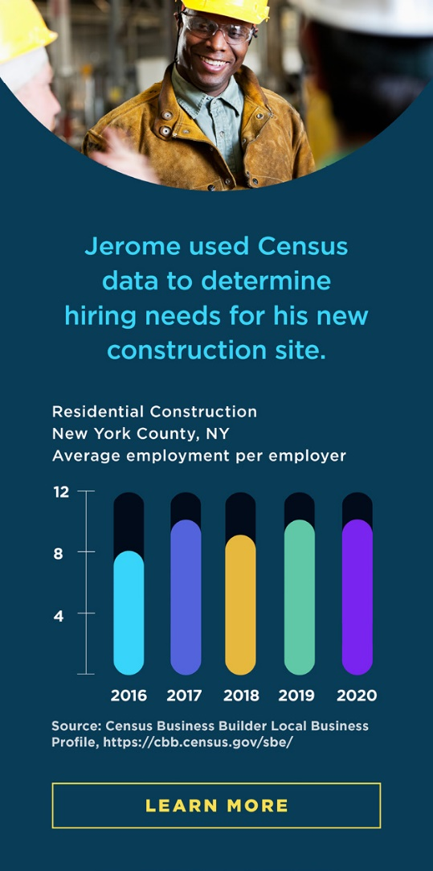
2023 Research Findings
Survey respondents simply want to know that the information they provide is being used and that Census data exist – they will likely just glance at data shown in the ads.
But data users are more likely to scrutinize the charts and data presented and think through how they would actually use them for decision making.
  They are looking to “connect the dots” from the statistics shown in the ad to use case.
There is need for more detailed data and stronger alignment with case examples in next-round Data Story ads.
NJ SDC Annual Meeting| October 5, 2023 | 21

Slide 22
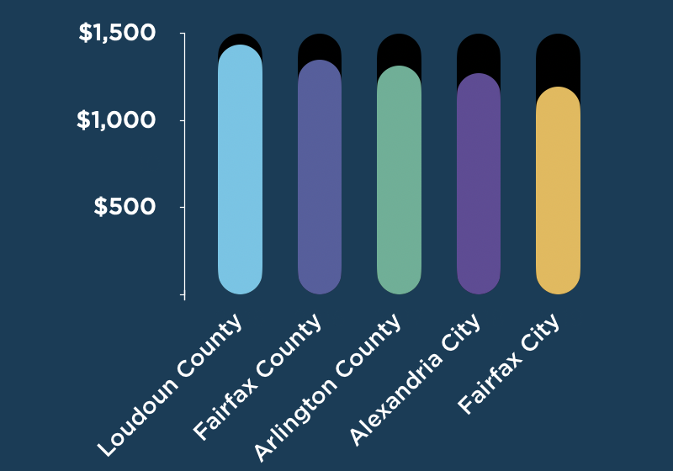

Phase 2 Data Stories – In Development
Annual Consumer Expenditures per Household on Women’s Apparel – Washington, D.C. suburbs
Grow your business with Census data.
MEET KARI
  Kari used Census Bureau data to help pick Loudoun County as the location for her new women’s clothing store outside Washington, D.C.
Census economic statistics are free and available online. LEARN MORE
Loudoun County, Virginia – Census Statistics
$1,436
Annual spending per household on women’s apparel (2021)
50.0%
Female
28
Women’s clothing stores, employer establishments (2021)
Source: Census Business Builder Local Business Profile, <https://cbb.census.gov/sbe>

Slide 23
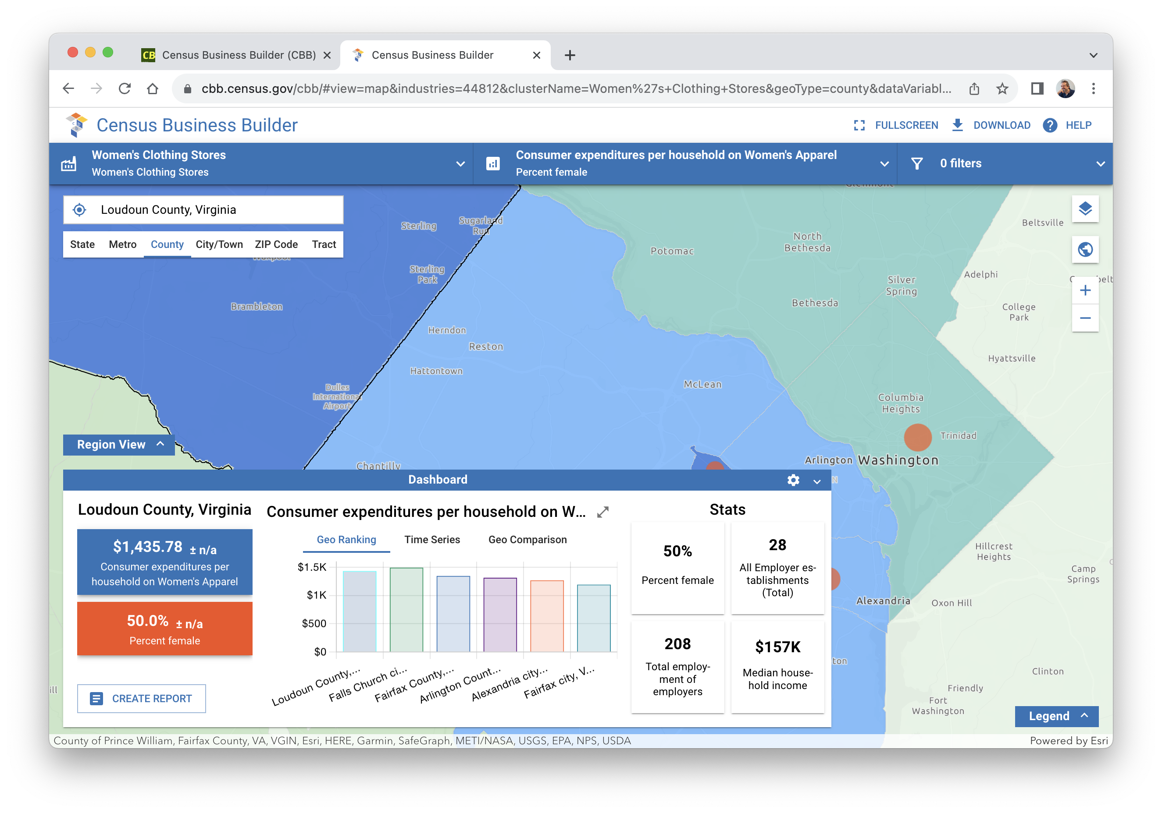
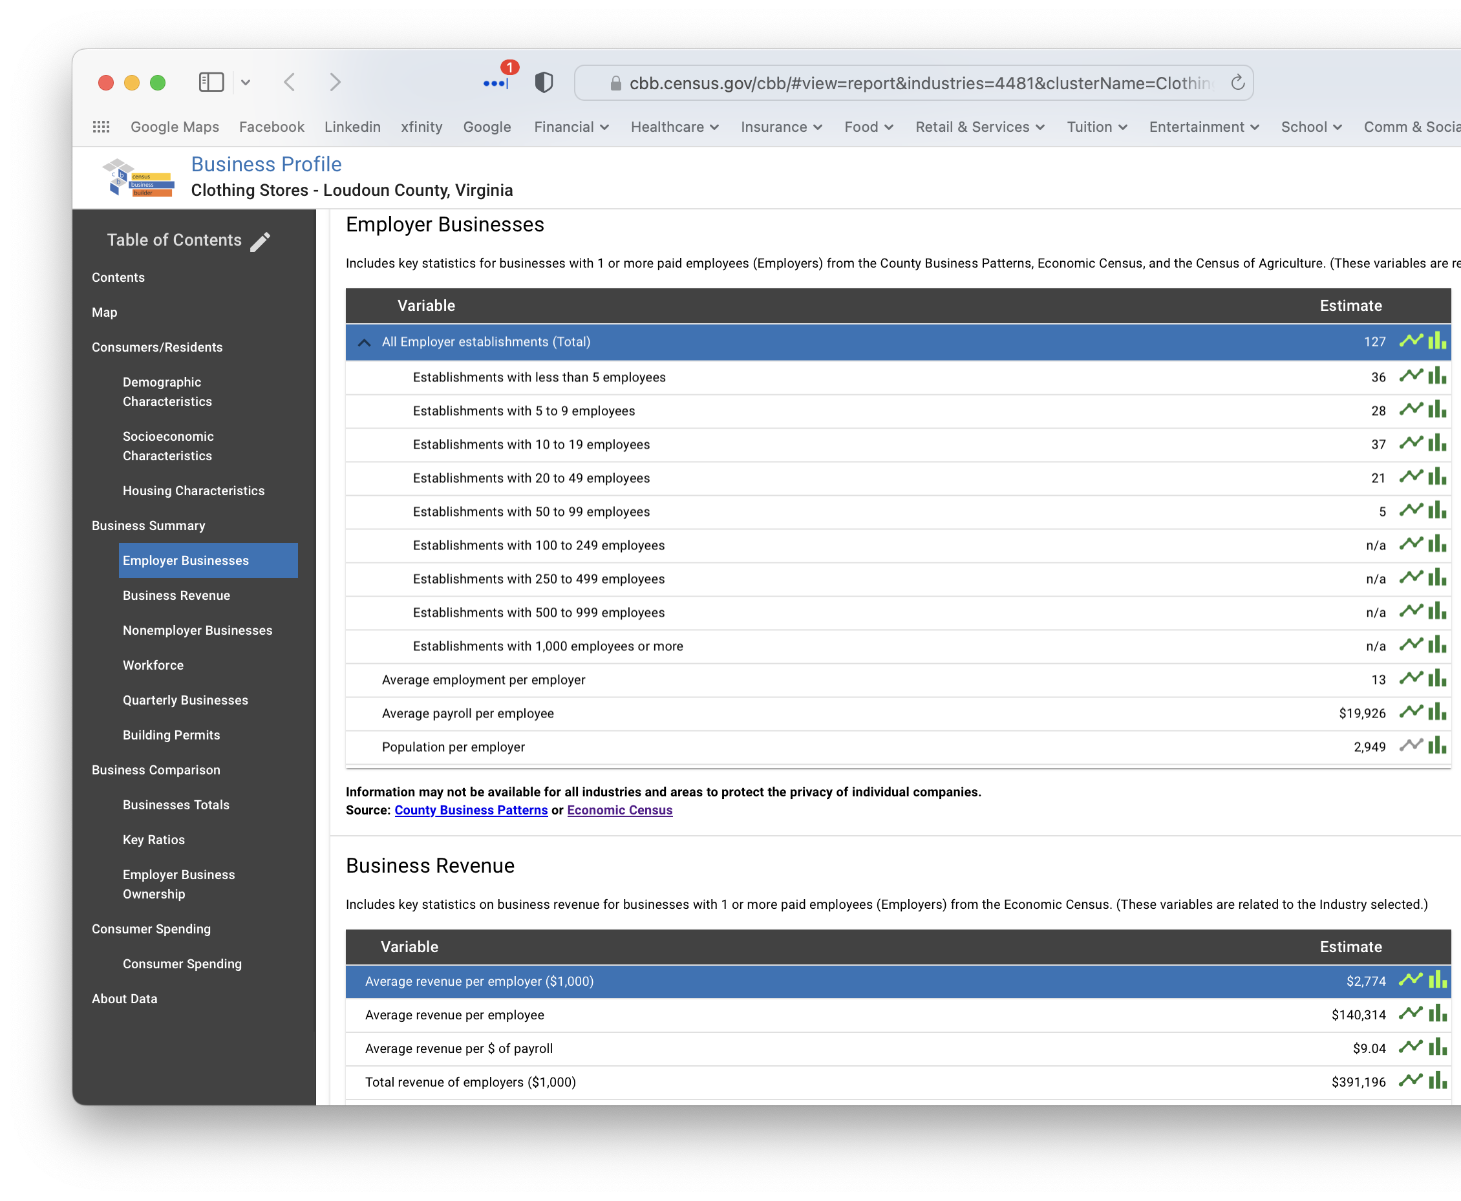
Phase 2 – In Development
Data from Census Business Builder

Slide 24

Annual Integrated Economic Survey

Slide 25
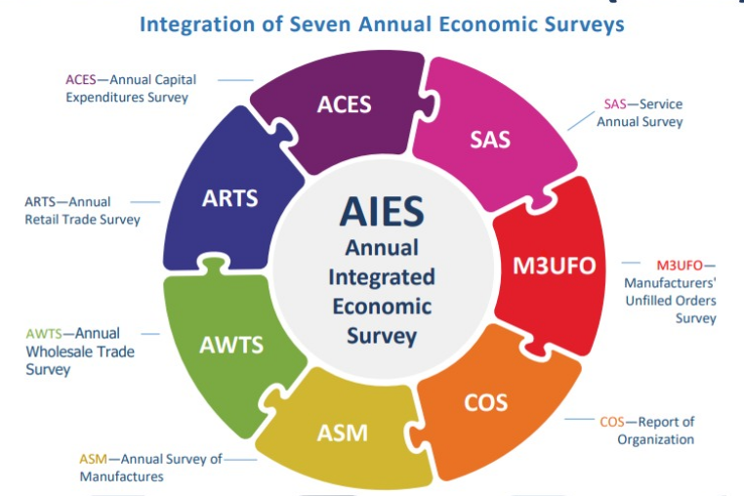
Annual Integrated Economic Survey (AIES)
Streamlined design that integrates and replaces seven existing annual business surveys into ONE single survey.

Slide 26
Annual Integrated Economic Survey (AIES)
What is collected in the AIES?
Current questions from seven existing annual surveys
Wide range of economic data including:
Business Characteristics & Classifications
Revenues
Operating Expenses
Assets
Robotic Equipment
Other Trade or Industry Specific Content
Data across industries and sectors
Geographic location
Employment
Agriculture
Mining
Manufacturing
Construction
Wholesale
Retail
Services

Slide 27
Annual Integrated Economic Survey (AIES)
Next Steps:
- Sample collection begins by invitation - Fall of 2023
- Existing annual surveys begin transition process - Winter 2023
- AIES Launch - Spring 2024
More information/updates can be found at : www.census.gov/aies
Contact us at: ECON.AIES.Help@census.gov

Slide 28

Q & A

Slide 29
Thank You
Charles.F.Brady@census.gov
(301) 763-6707

